Slide 1
Transient Passages and Varied Ambiances
What 5 years at art school achieved
Notes:
Introduce myself
Maths
CSM

Slide 2
Three of my works and their philosophical influences
Guy Debord and the concept of Dérive.
Debord’s theory is a revolutionary action which involves
making an unplanned journey through an urban landscape.
Your movements are dictated by the encounters you have
with the terrain. You are responding to the
psychogeography of the urban landscape.

Slide 3
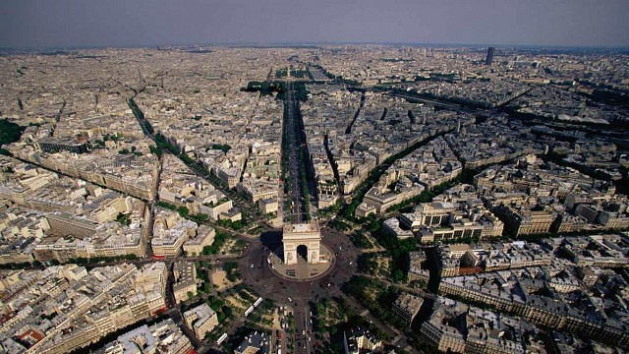
The Arc de Triomphe in Paris is a key part of the historic axis of
monuments and boulevards that ‘guide’ the viewer and aim to
instil a sense of wonder.
The Dérive is a direct confrontation to this form of control.

Slide 4
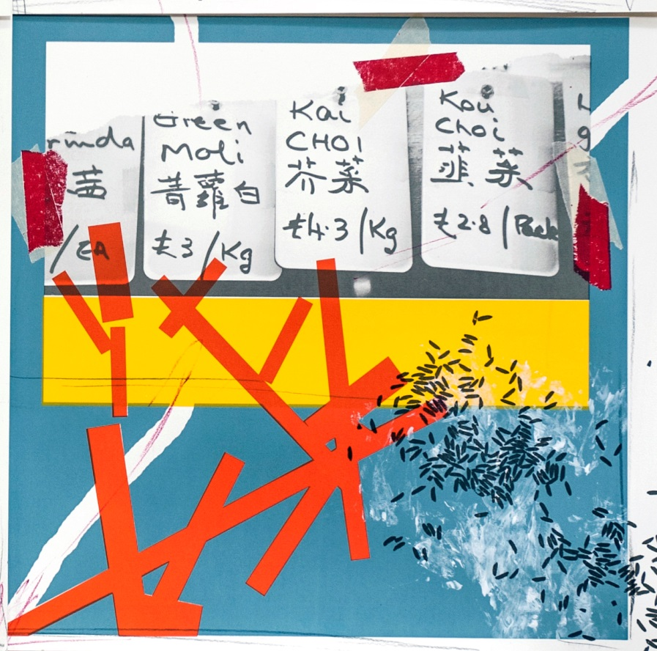
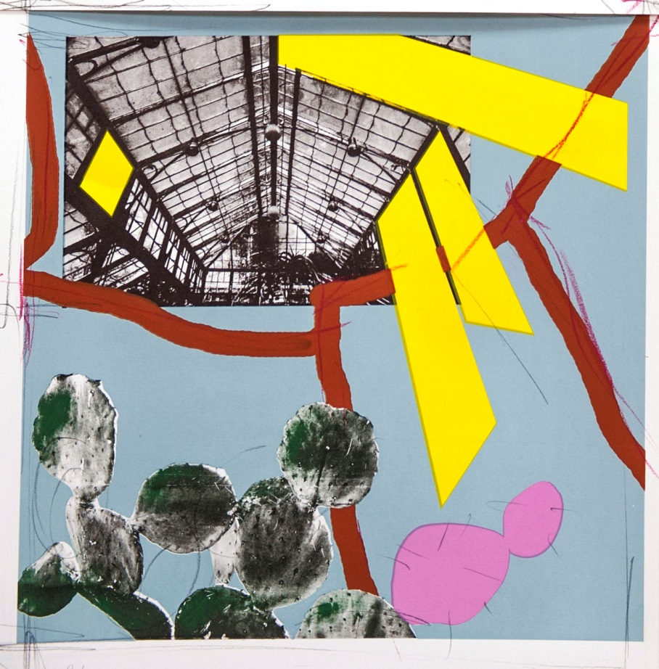
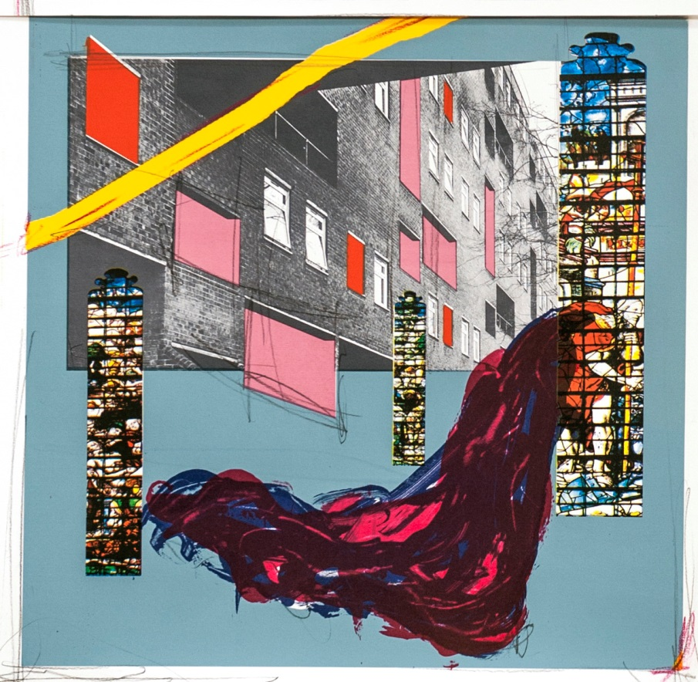
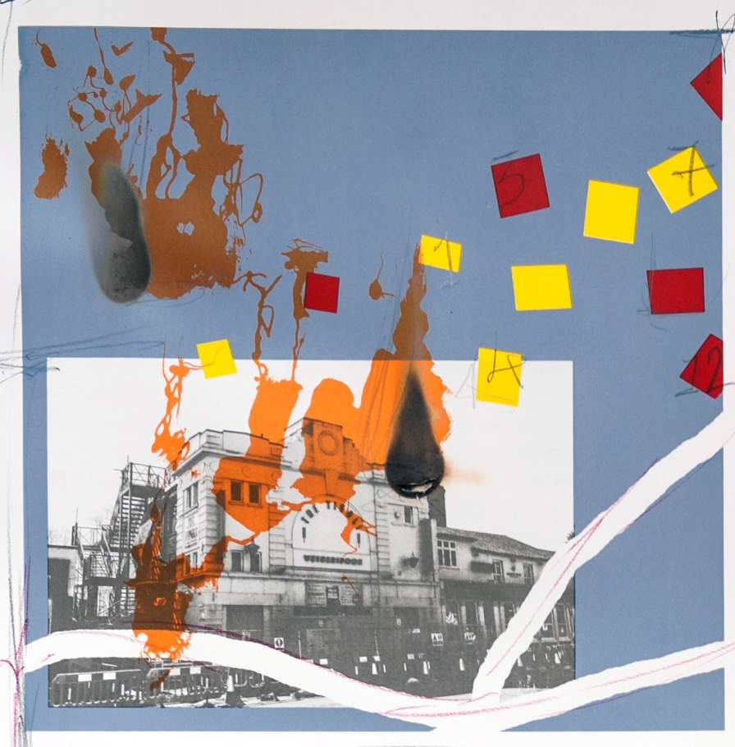
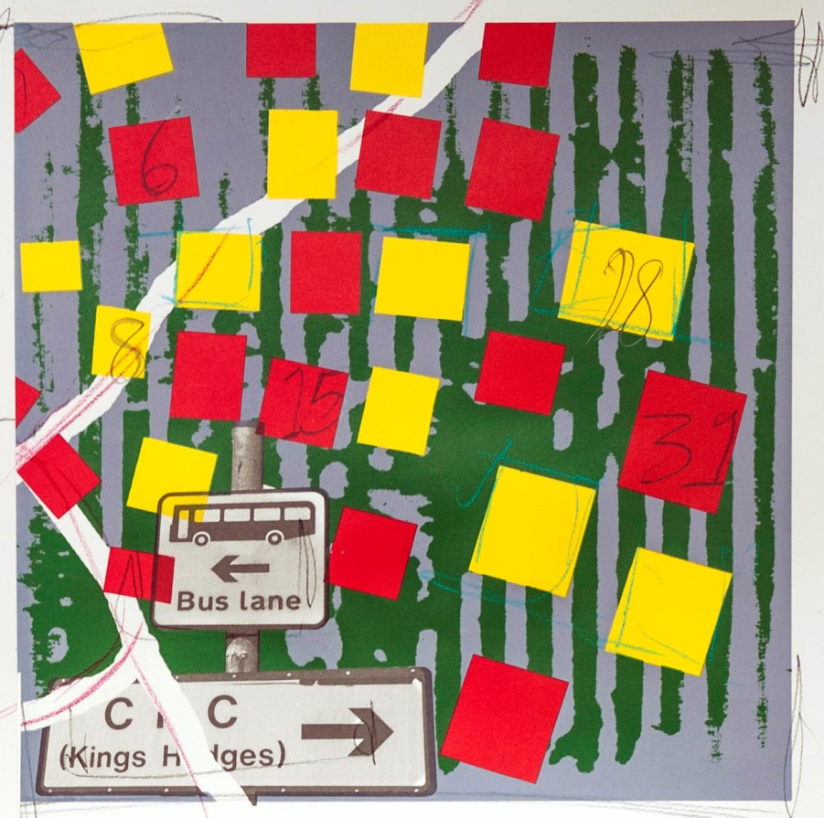
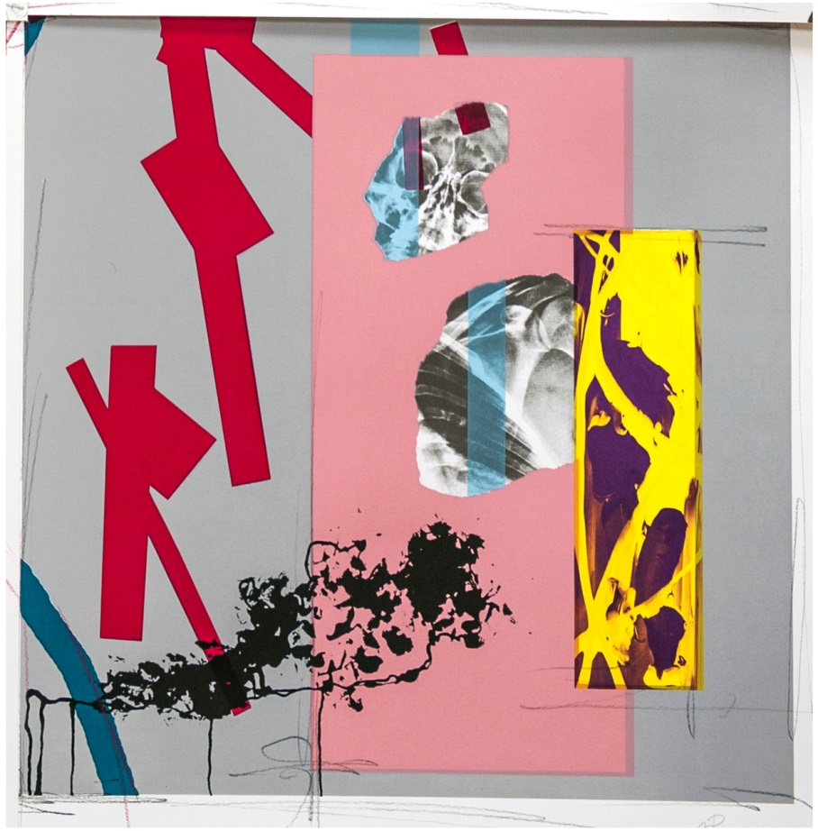
Transient Passages and Varied Ambiances
Notes:
Aim to create pieces that could work individually but which also are part of a larger narrative

Slide 5
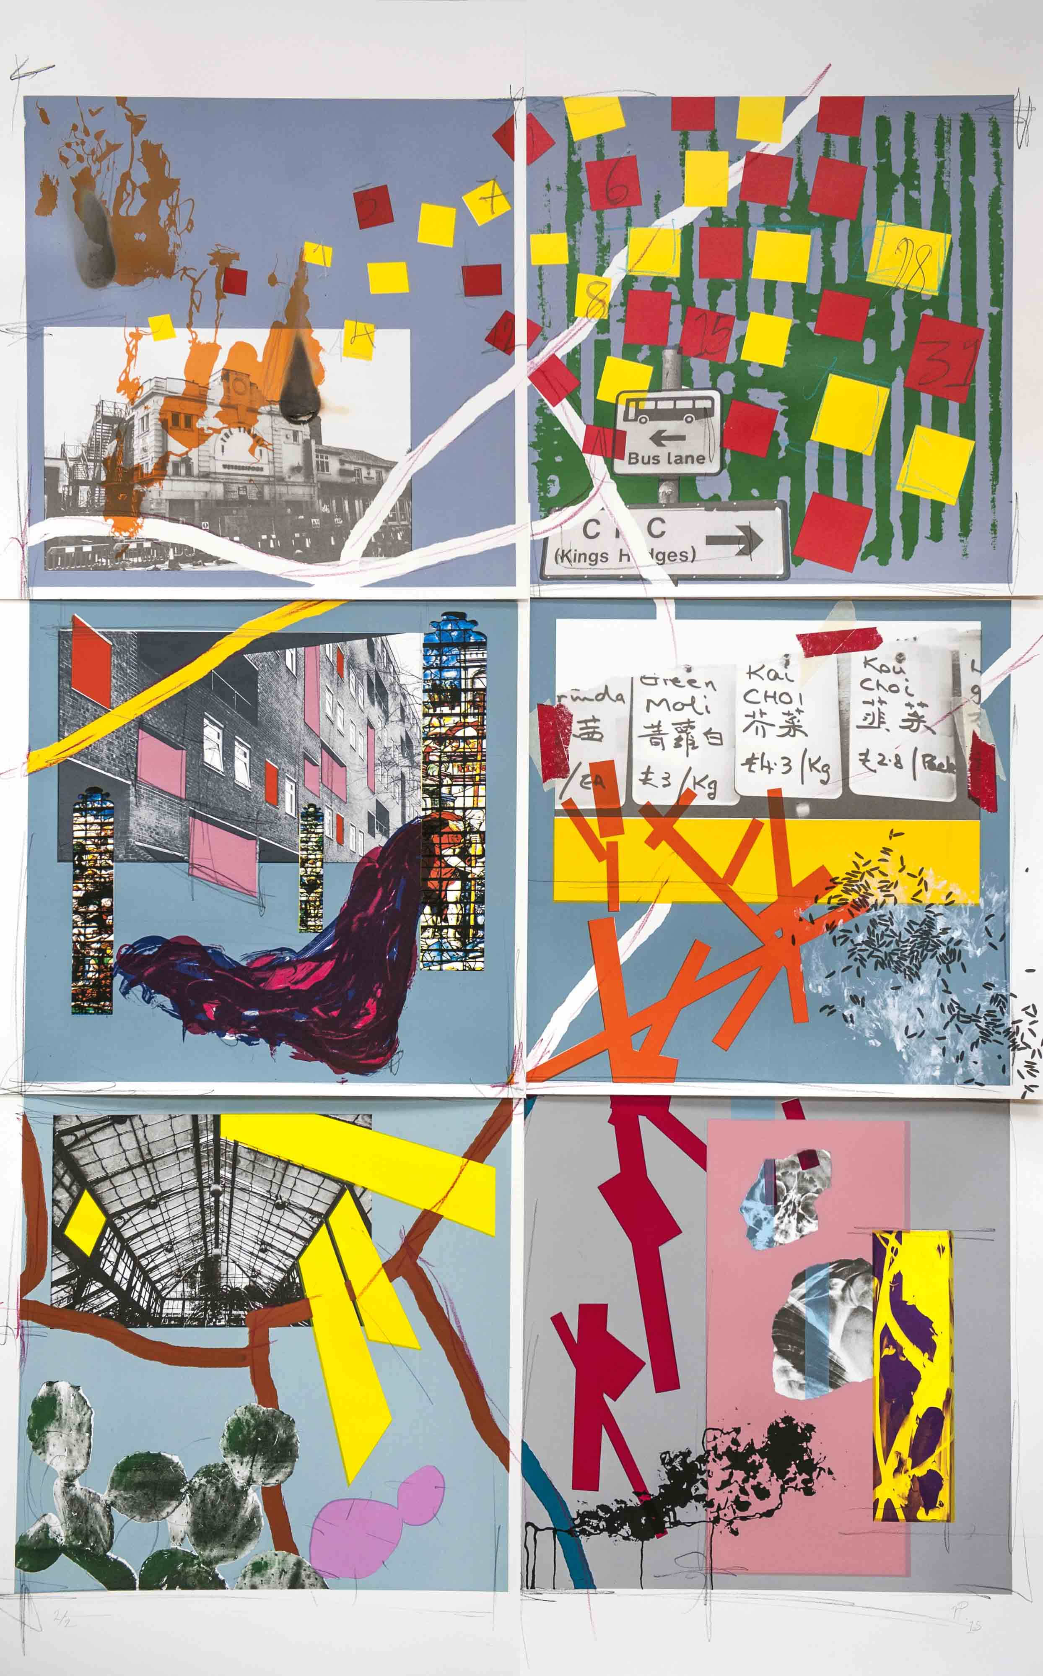

Slide 6
The Sensational Case of Dr. Gillies
Nicolas Bourriaud and Relational Aesthetics.
Bourriaud put forward the theory that art had moved
away from the need to have a visually aesthetic quality.
Contemporary art was increasingly being judged on how
human emotions interacted with it and also its wider
social context.
Notes:
Note there is a distinction between art that affects the viewer on an emotional level and one in which the emotion is an integral part of the work. You could argue that Picasso’s Guernica painting creates an emotional response, however that emotional response is not fundamental to whether it is a good piece of artwork.

Slide 7
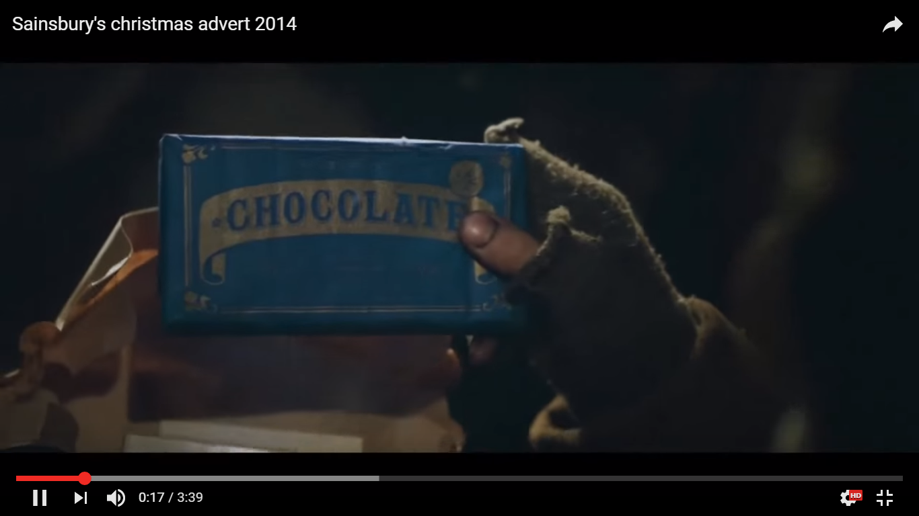
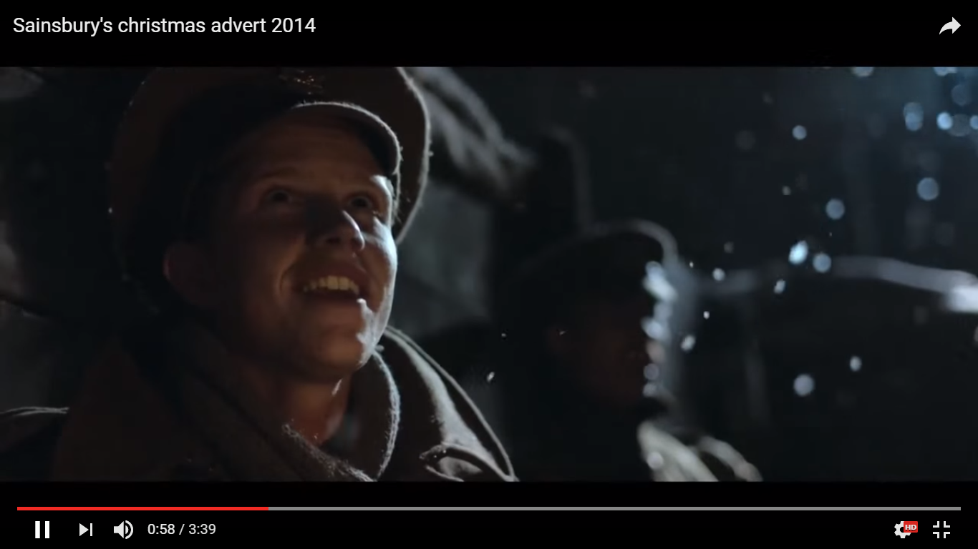
Notes:
Sainsbury’s Xmas Ad 2014. My issues with it are as follows:
The use of a human tragedy to sale groceries
The overly sanitised depiction of war
The nostalgic tone of the ad

Slide 8
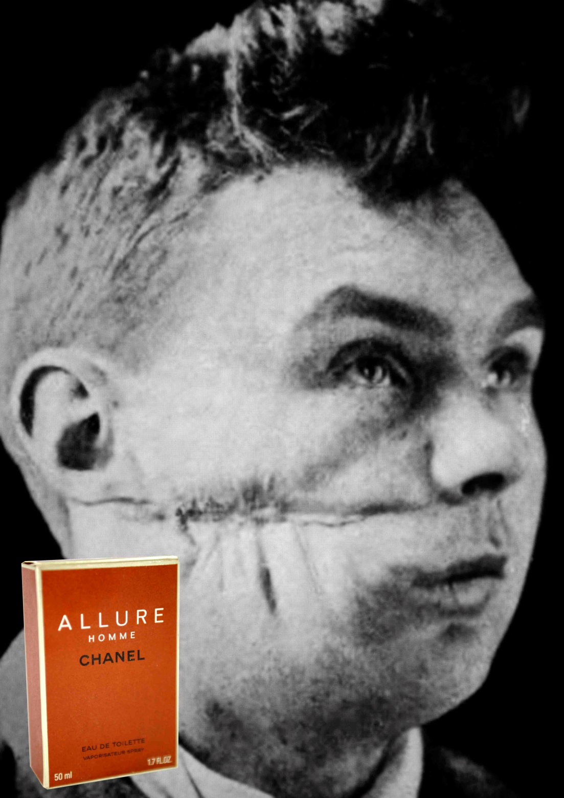
Notes:
Dr. Gillies was a pioneering surgeon specialising in facial disfigurements during WW1. He documented the injuries of the soldiers he treated with written descriptions but also diagrams and photographs.
When (if ever) is it OK to use war as an advertising prop?
Does the endorsement of the Royal British Legion legitimise it?

Slide 9
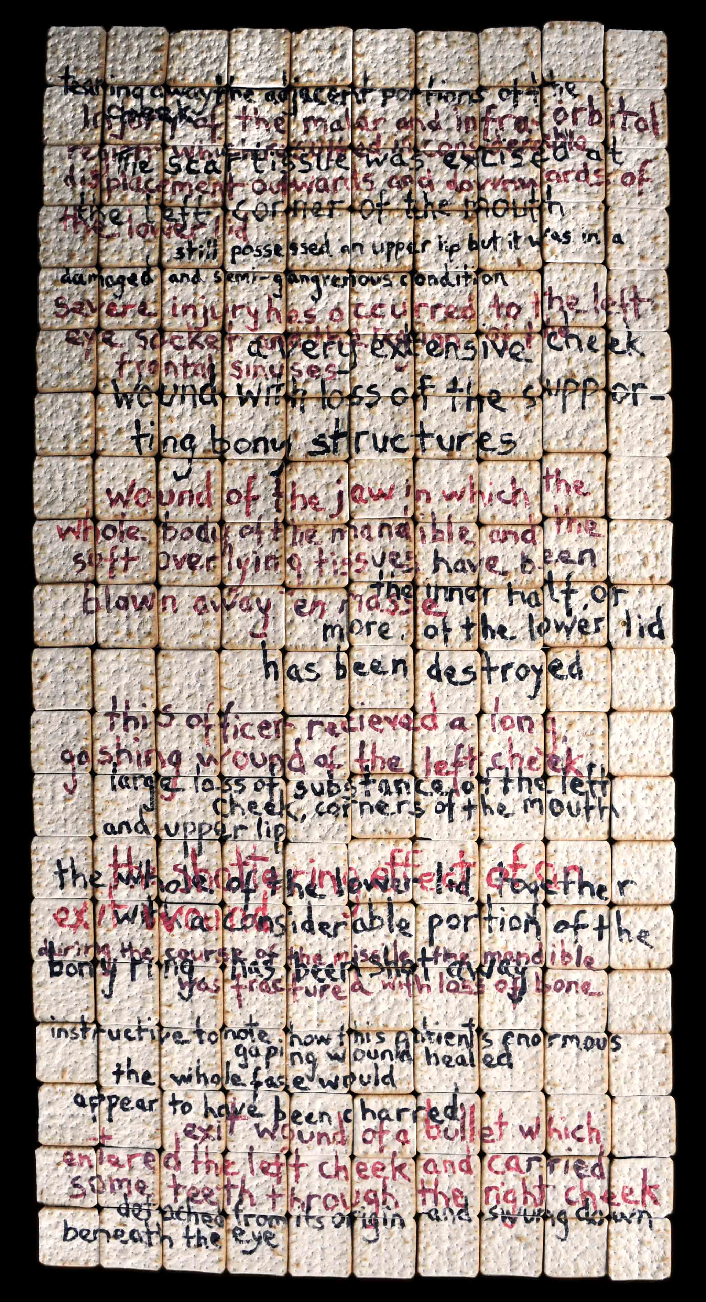
Notes:
Extracts from Dr. Gillies notes painted on a rectangular array of cream cracker biscuits.
The use of biscuits is symbolic. Fragility of historical documentation and collective memory.

Slide 10
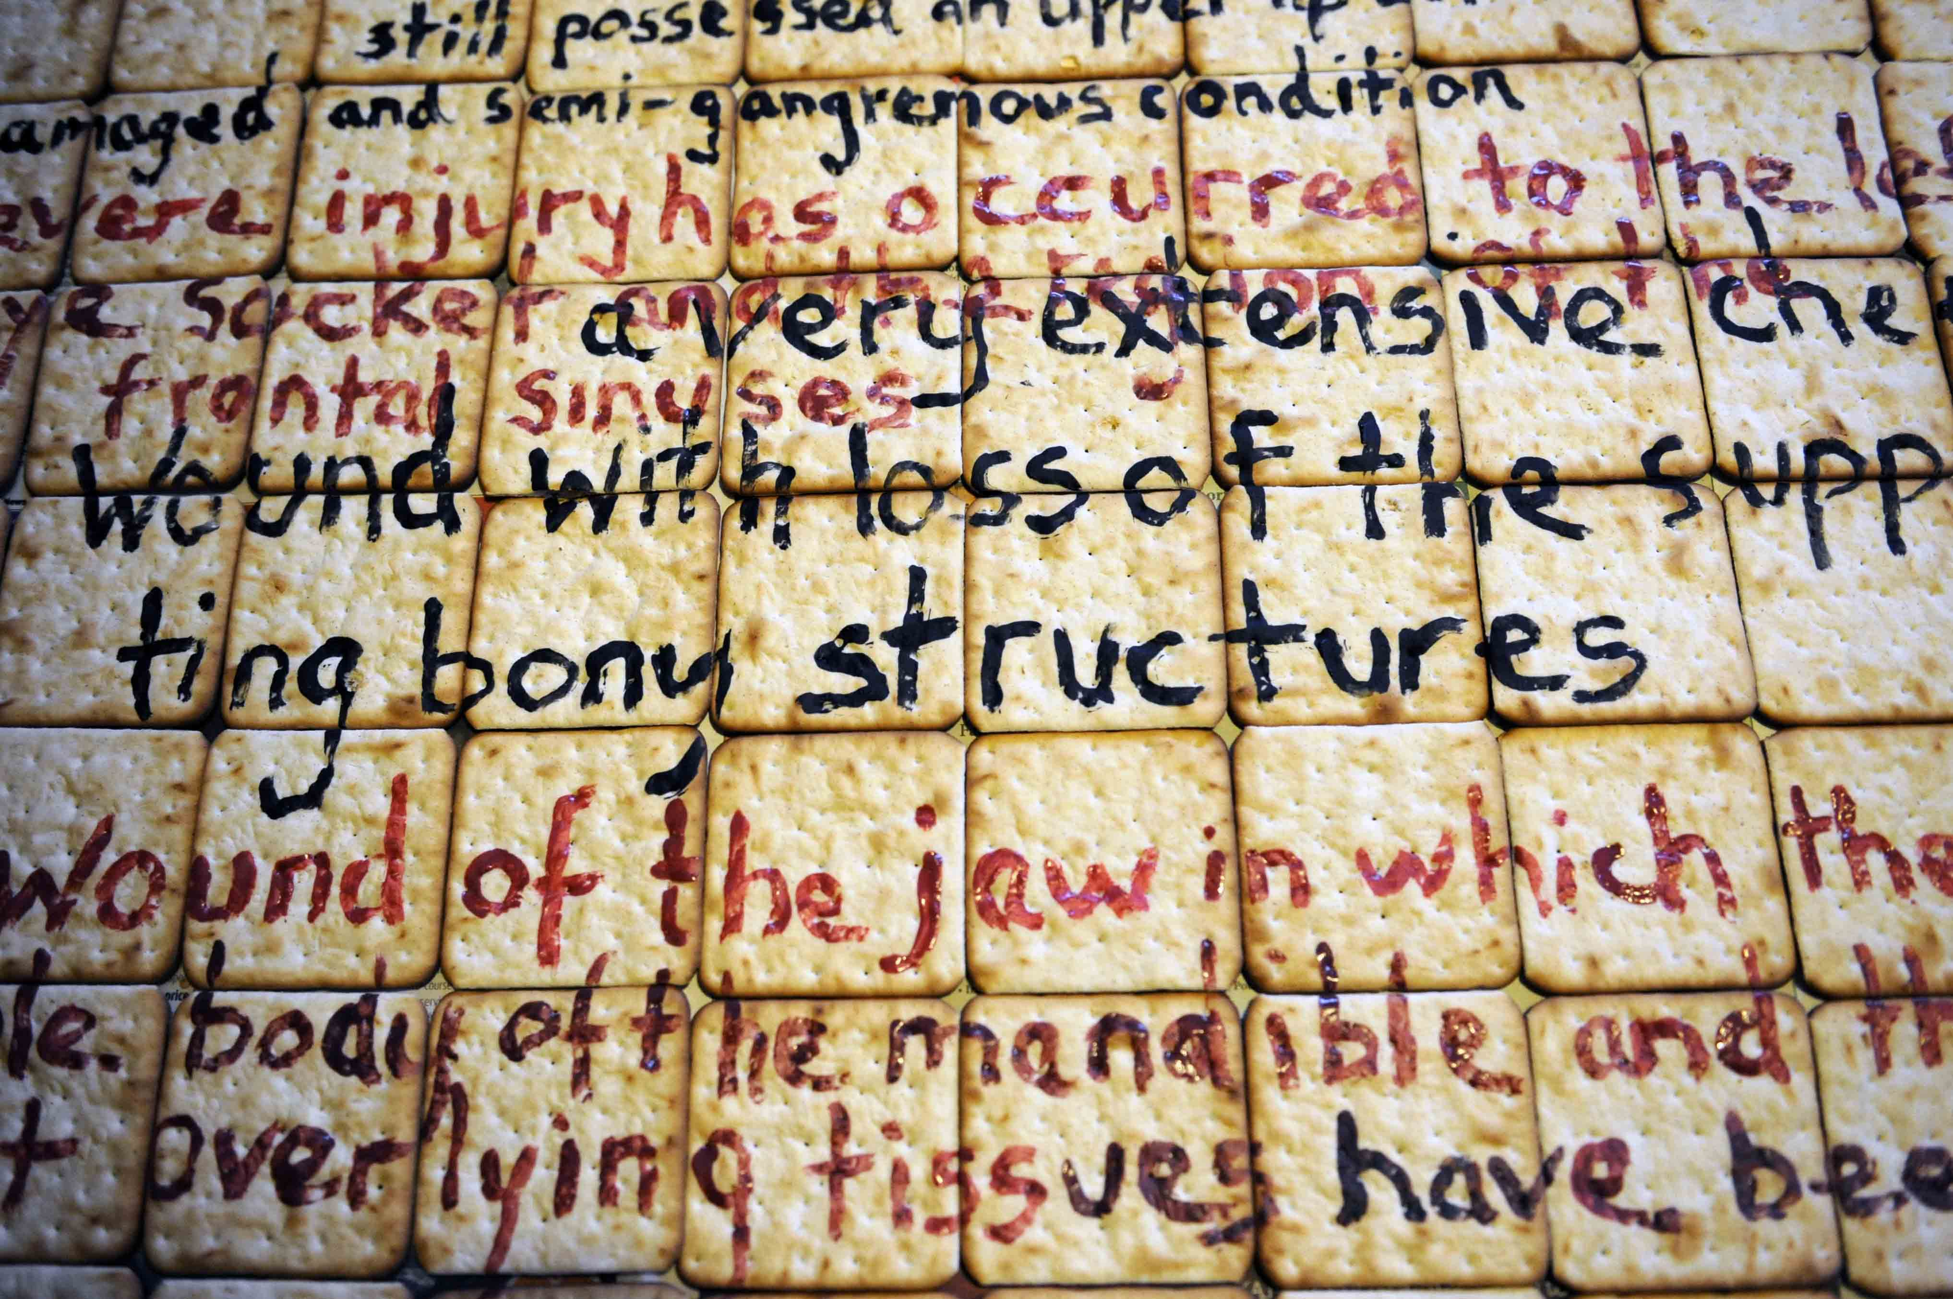

Slide 11
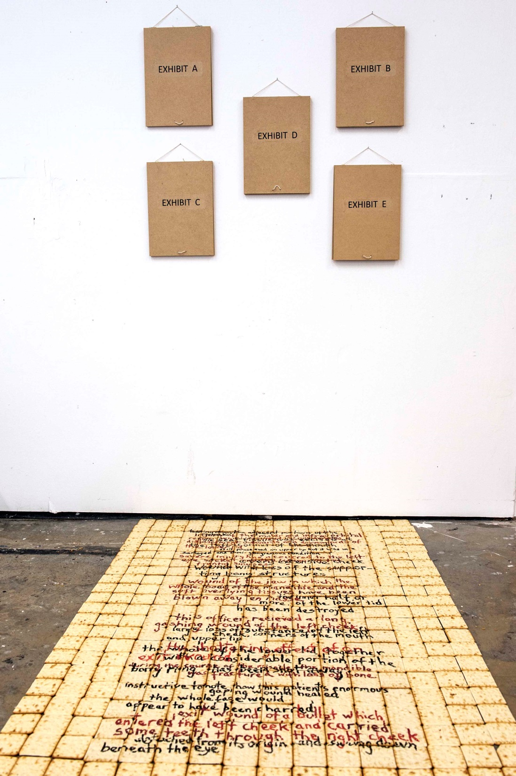
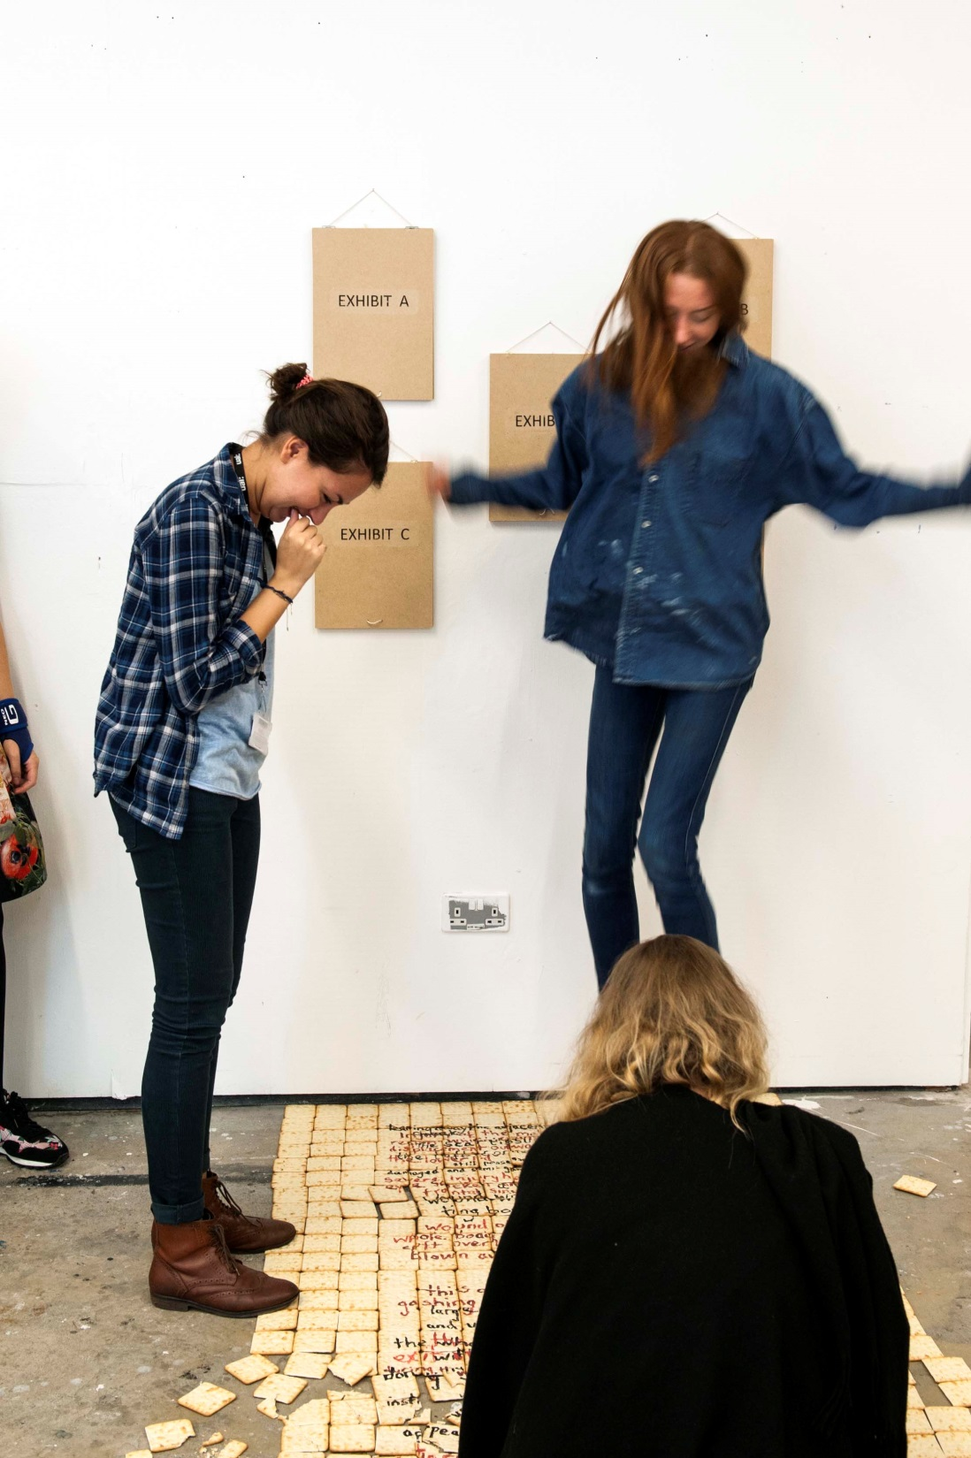
Notes:
The installation consists of 5 flip boards labelled Exhibit A, B, C etc. The lid of the flip board conceals the image beneath (images of facial injuries during WW1 superimposed with a product e.g. toothpaste, aftershave etc).
Directly beneath the boards, on the floor is the array of biscuits containing extracts from Dr. Gillies’ notes. (Ideally the biscuits would cover a wider floor area to prevent people accessing the flip-boards from the side). The objective was to force people to walk on the biscuits in order to view the flip-boards, thereby crushing the text.
The second image shows students who were asked to interact/view the installation. Once the question had been raised whether they could walk on the biscuits, the temptation proved too great and they were jumped on (before anybody had even read the text)

Slide 12
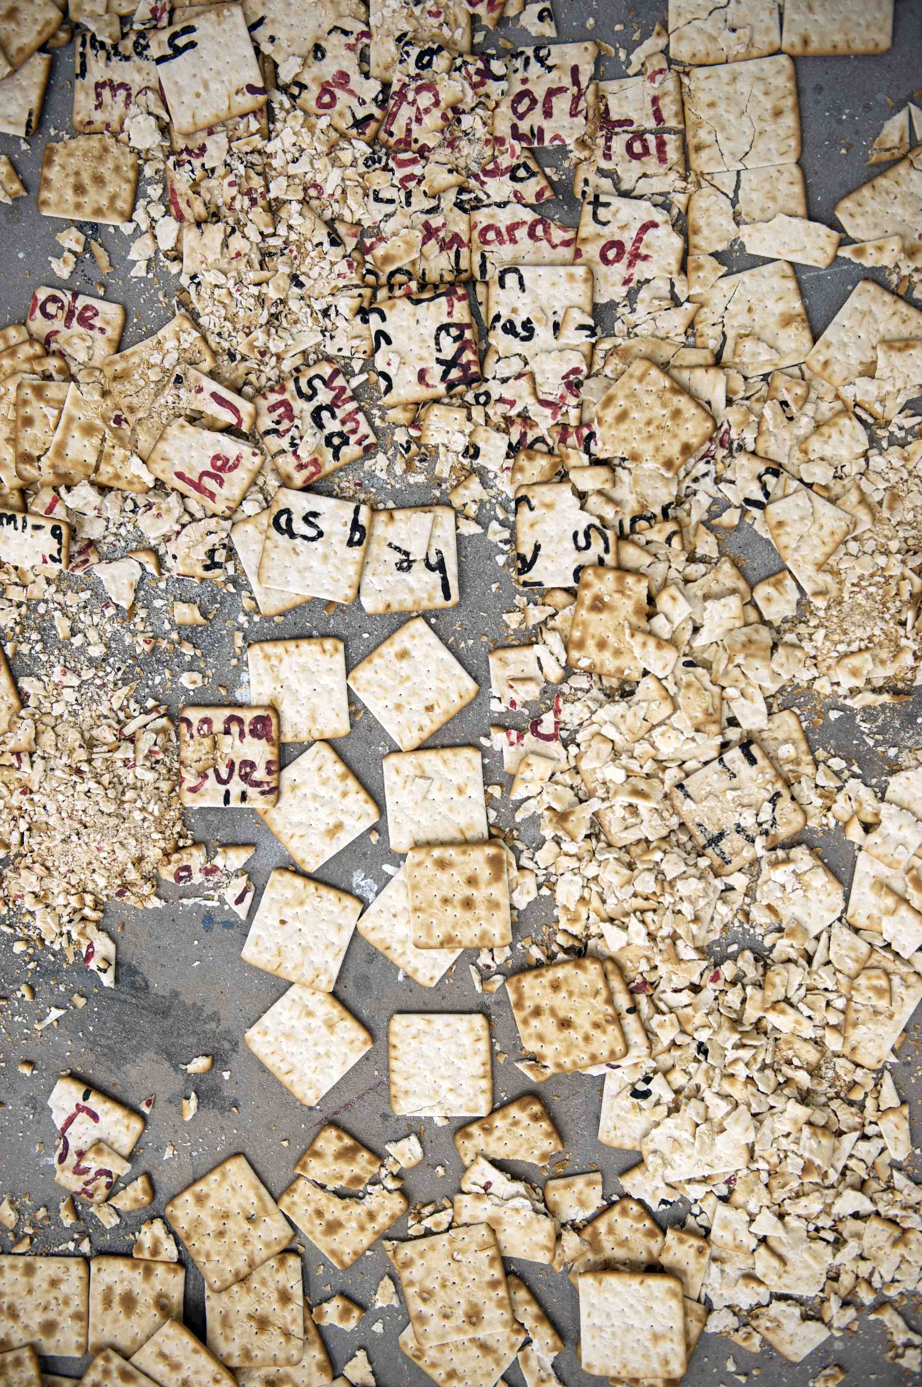
Notes:
Only after the novelty of jumping on biscuits had worn off did students look at other aspects of the installation, by which time the damage had been done.
This reinforced the notion that it is easy to lose the memory of the past.

Slide 13
Degree Show: 2U5IT4NIA Installation
Appropriation of the image
Misuse of the historical image
Relational Aesthetic
Audience complicity
2U5IT4NIA
Screen Printing
Pinhole Photography
Distressed film
Décollage
Print on Aluminium
Lightboxes
Notes:
Top half aims of the degree show work
Bottom half, the methods eventually used

Slide 14
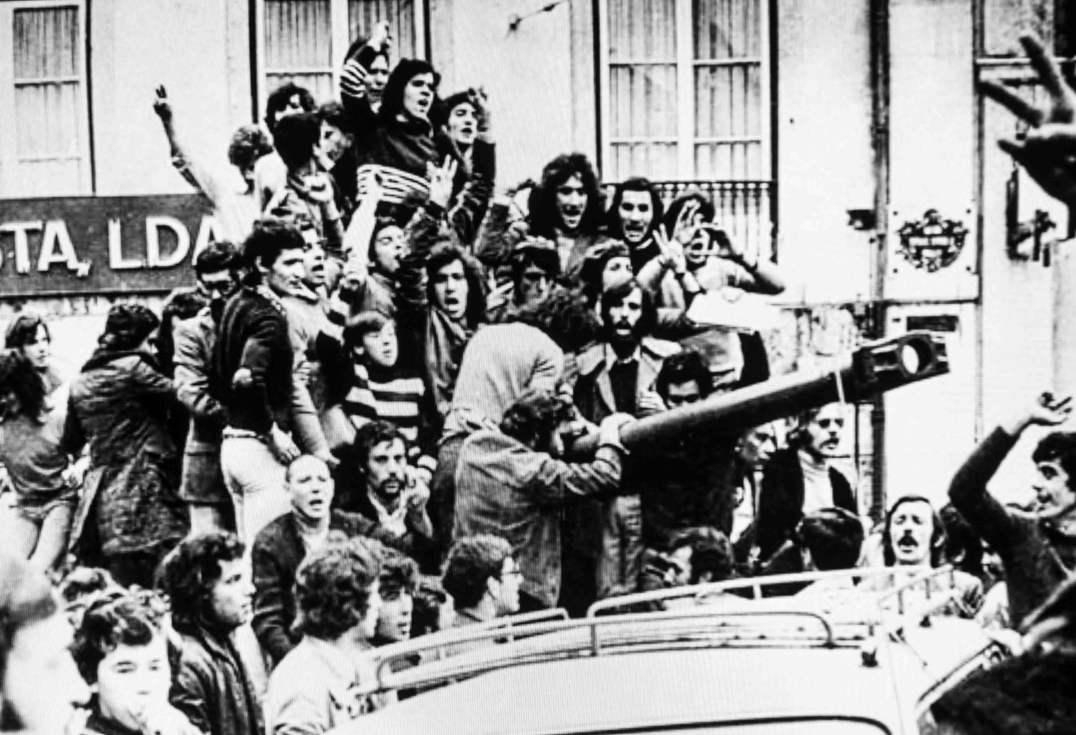
25 April 1974 The Portuguese revolution that toppled Fascism
Notes:
Portugal had been a Fascist dictatorship since 1933. It had also been embroiled in deeply unpopular colonial wars in particular in Angola and Mozambique.
This boiled over on the 25 April 1974 when elements of the military staged a coup and tens of thousands of people took to the streets.
Known as the Carnation revolution as people placed carnations in the muzzles of guns.
This is one of the famous photographs taken on that day

Slide 15
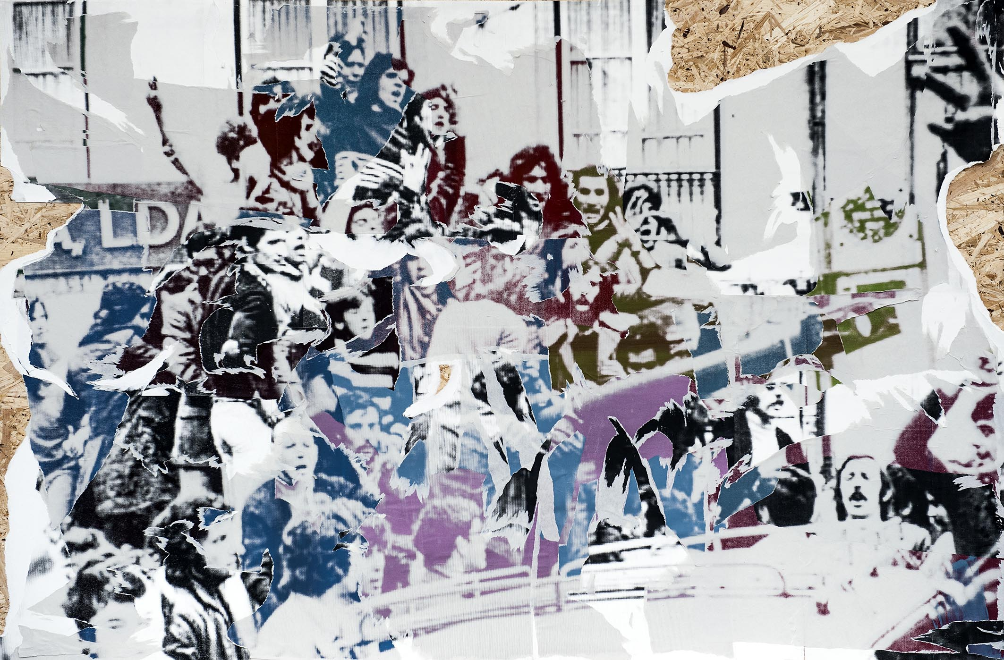
Notes:
I appropriated the image.
Screen printed the image in several parts and in several colours.
Pasted on strand board and then used the process of décollage. Here the images are peeled/torn off. Opposite to collage.
The aesthetic I was trying to recreate is similar to posters being pasted up in streets and that then over time they are torn away, replaced by others and are weathered. A key element to dissemination of revolutionary ideas/images.
The title 2U5IT4NIA, refers to the Roman name for the region now occupied by Portugal (Lusitania) and the date 25/4 which is the date of the Portuguese revolution.
Décollage as an art form was championed by artists of the nouveau réalisme, such as Wolf Vostell and Jacques Villegle

Slide 16
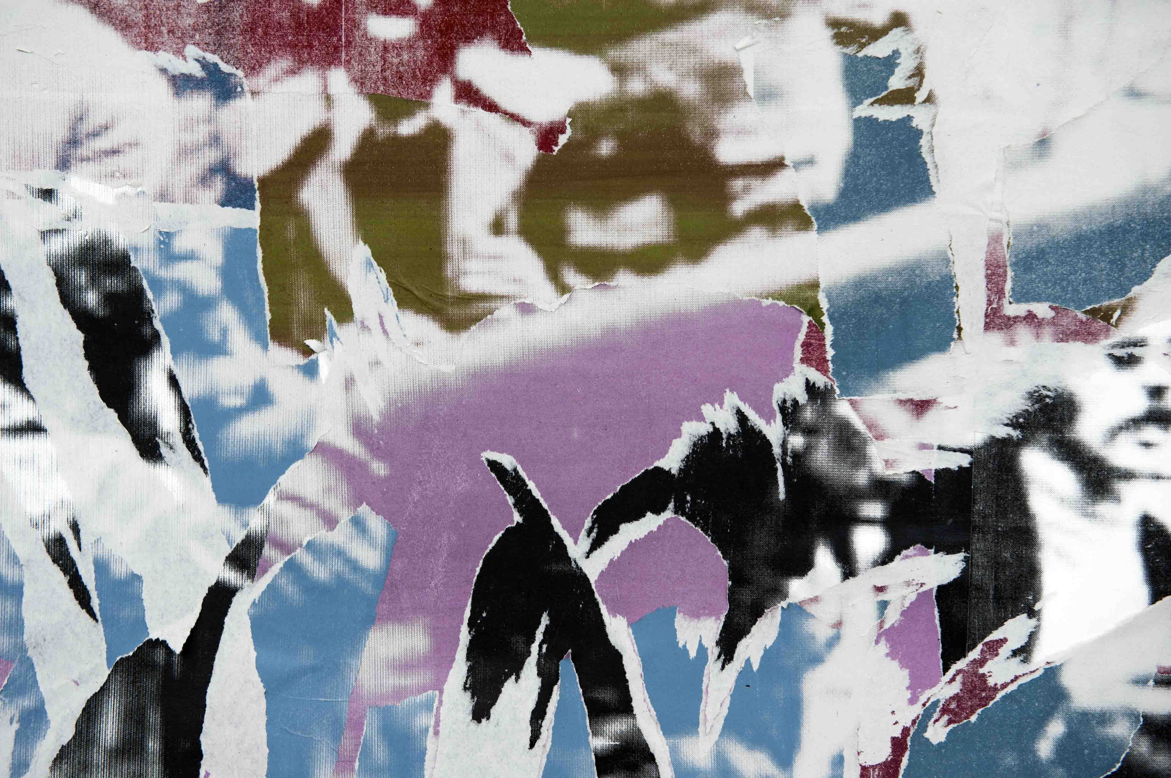
Notes:
Close-up of image

Slide 17
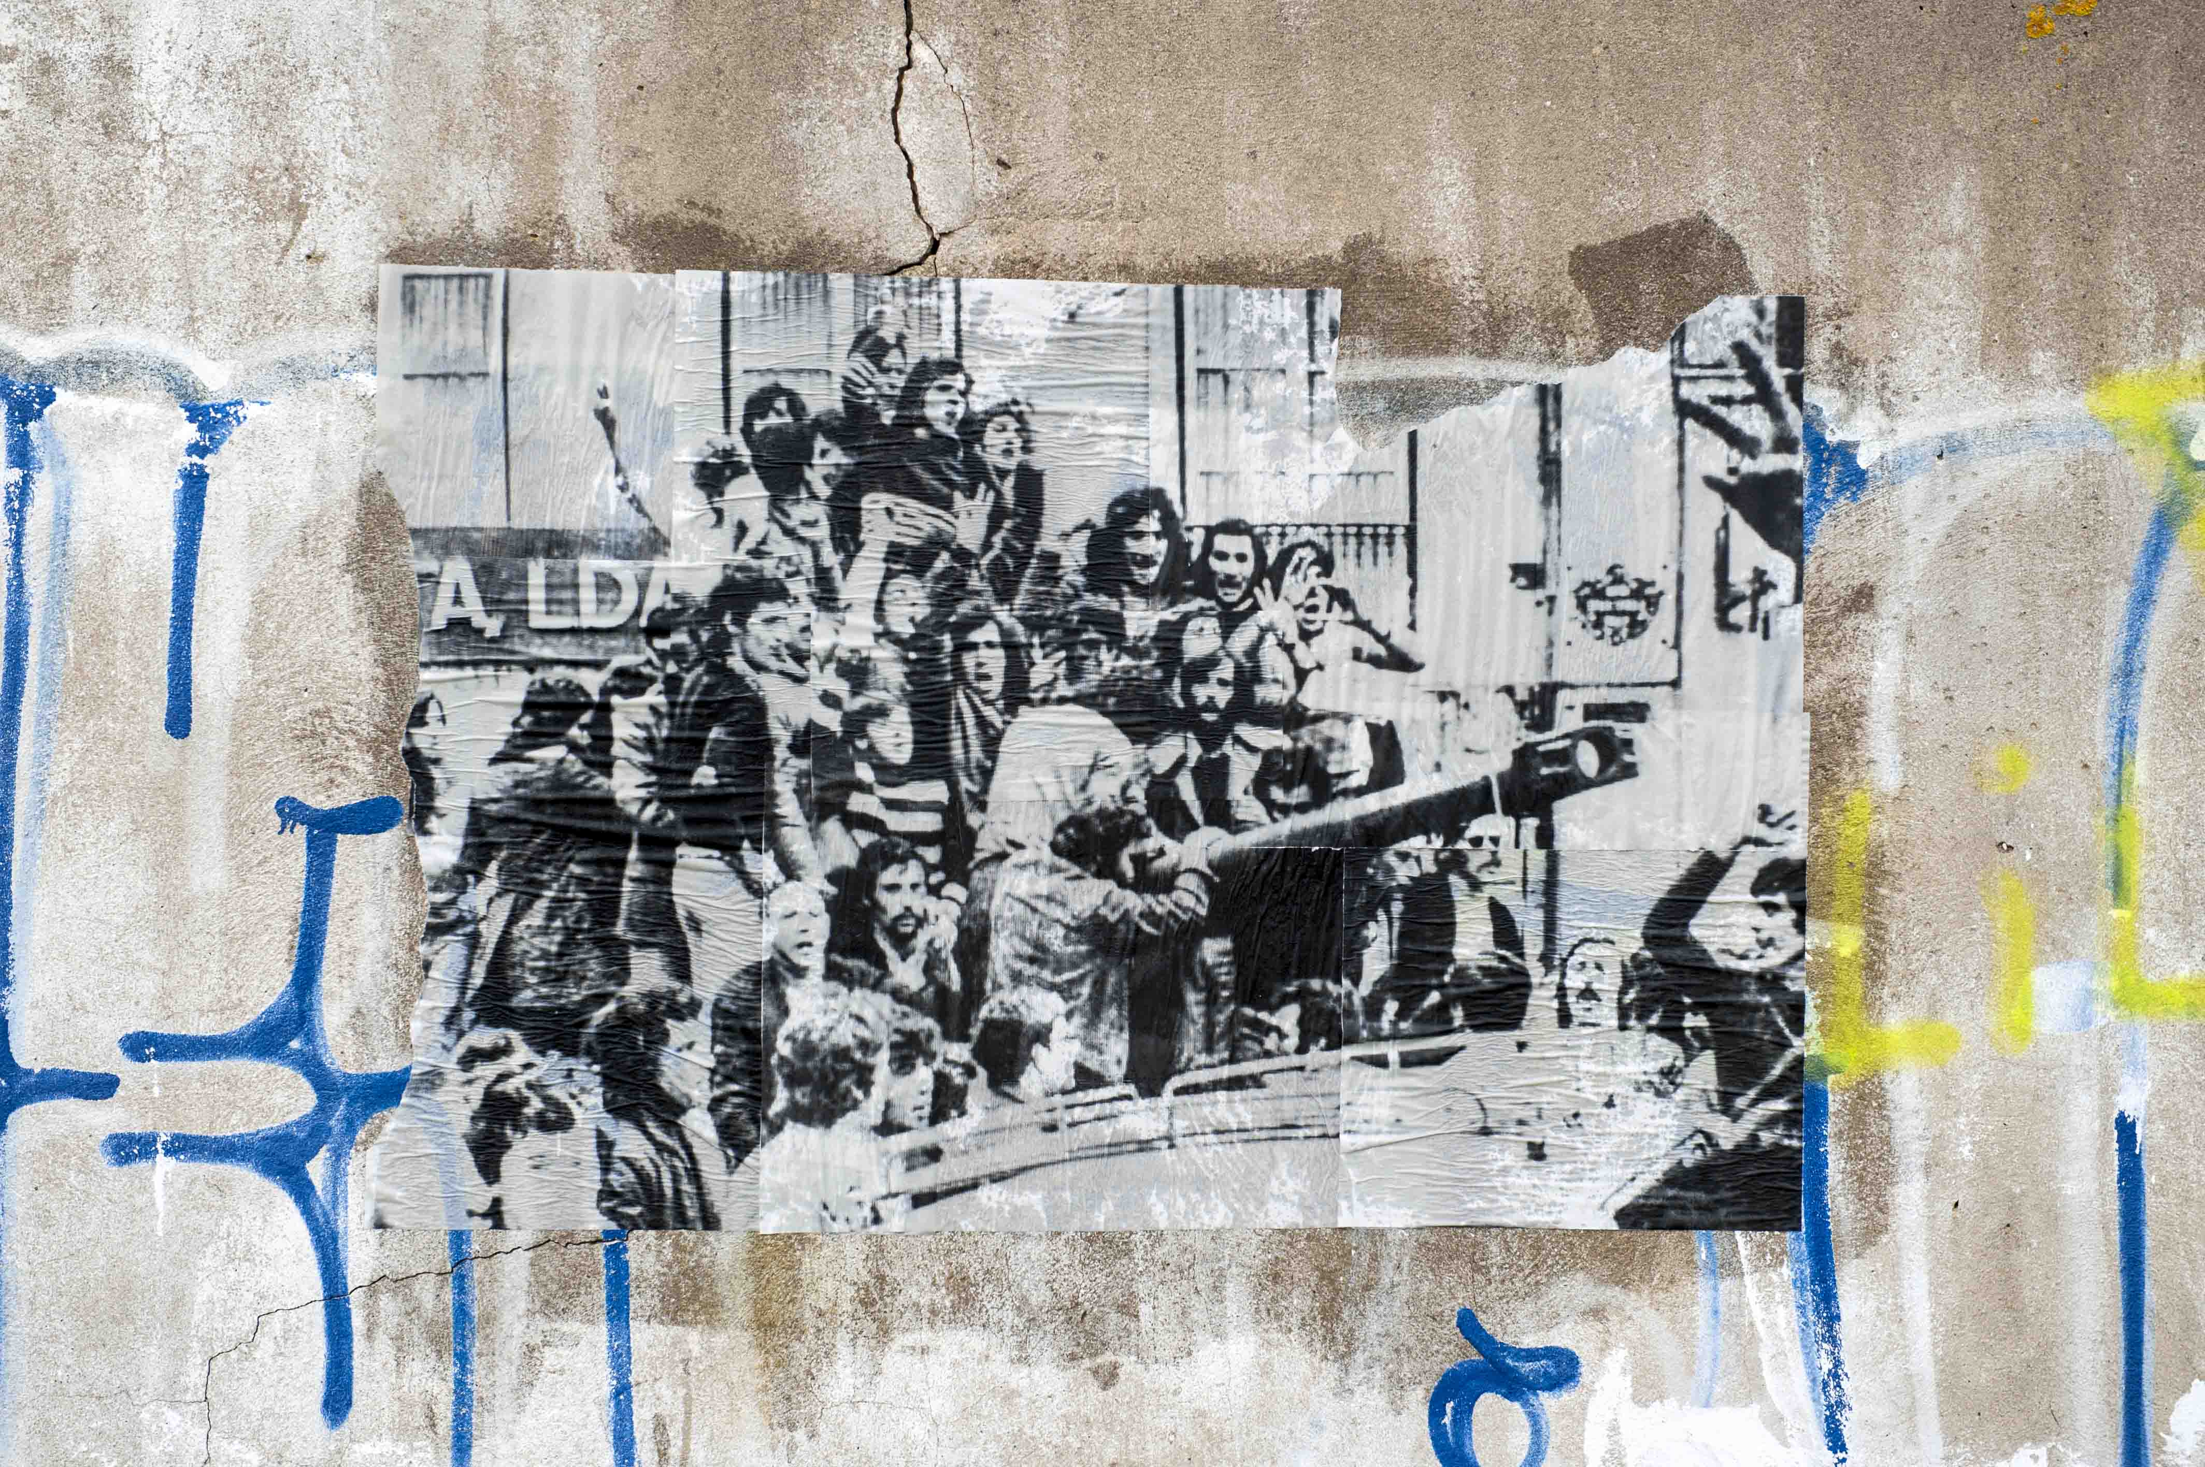
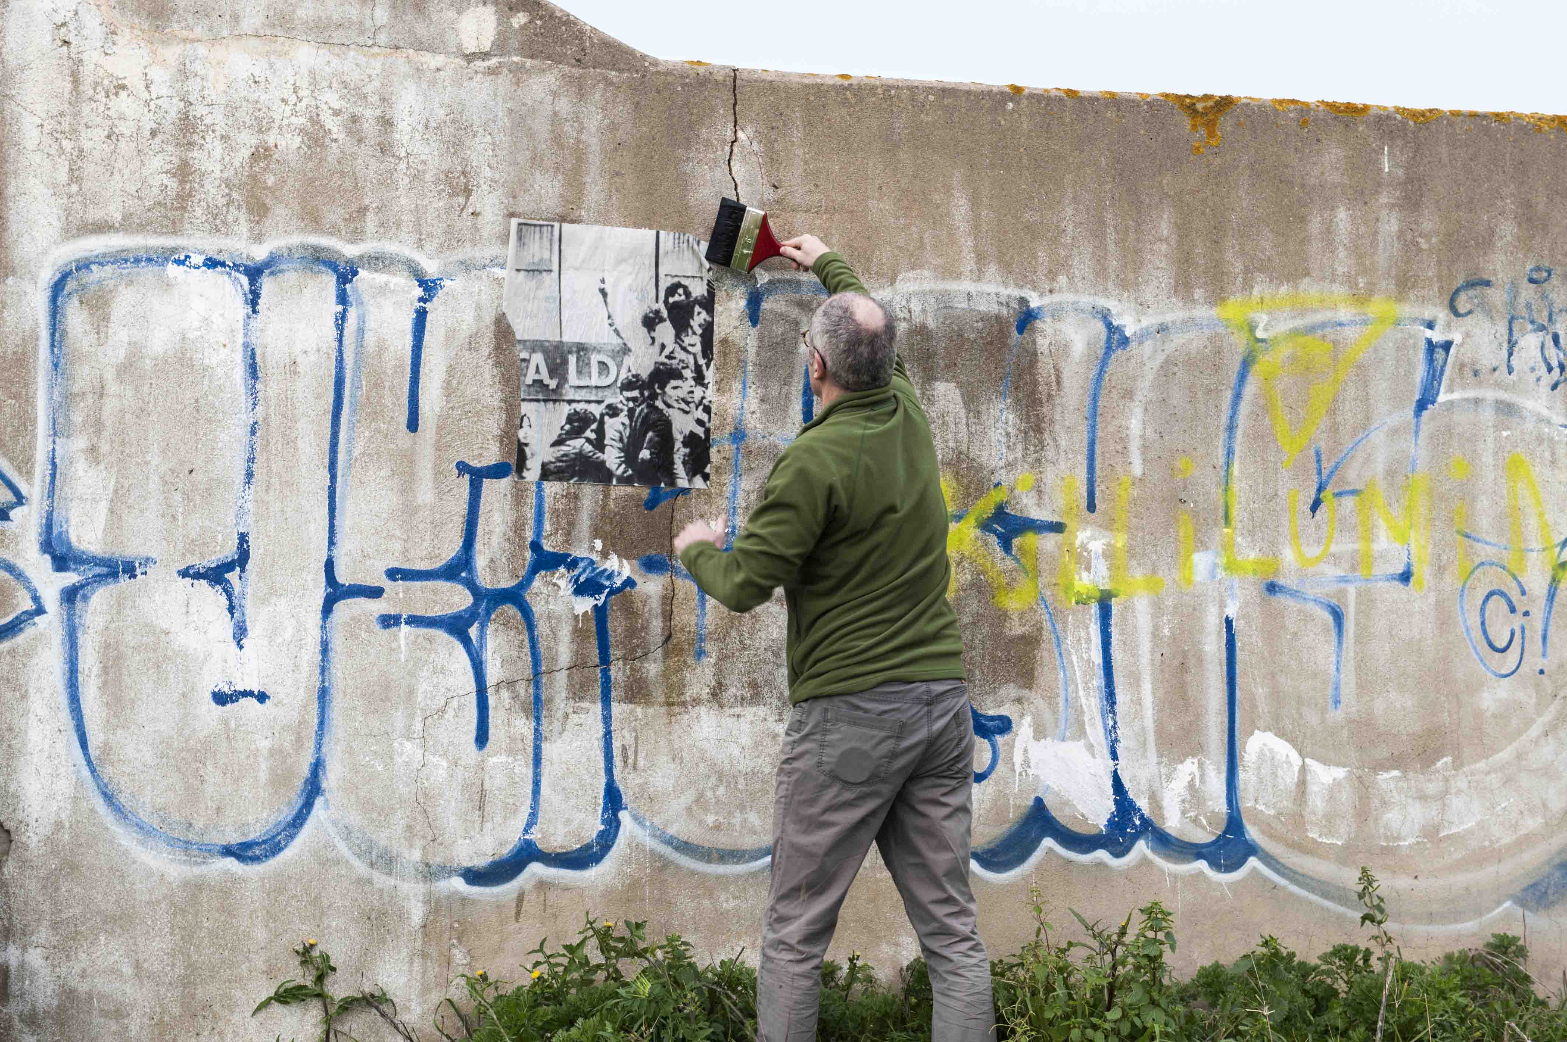
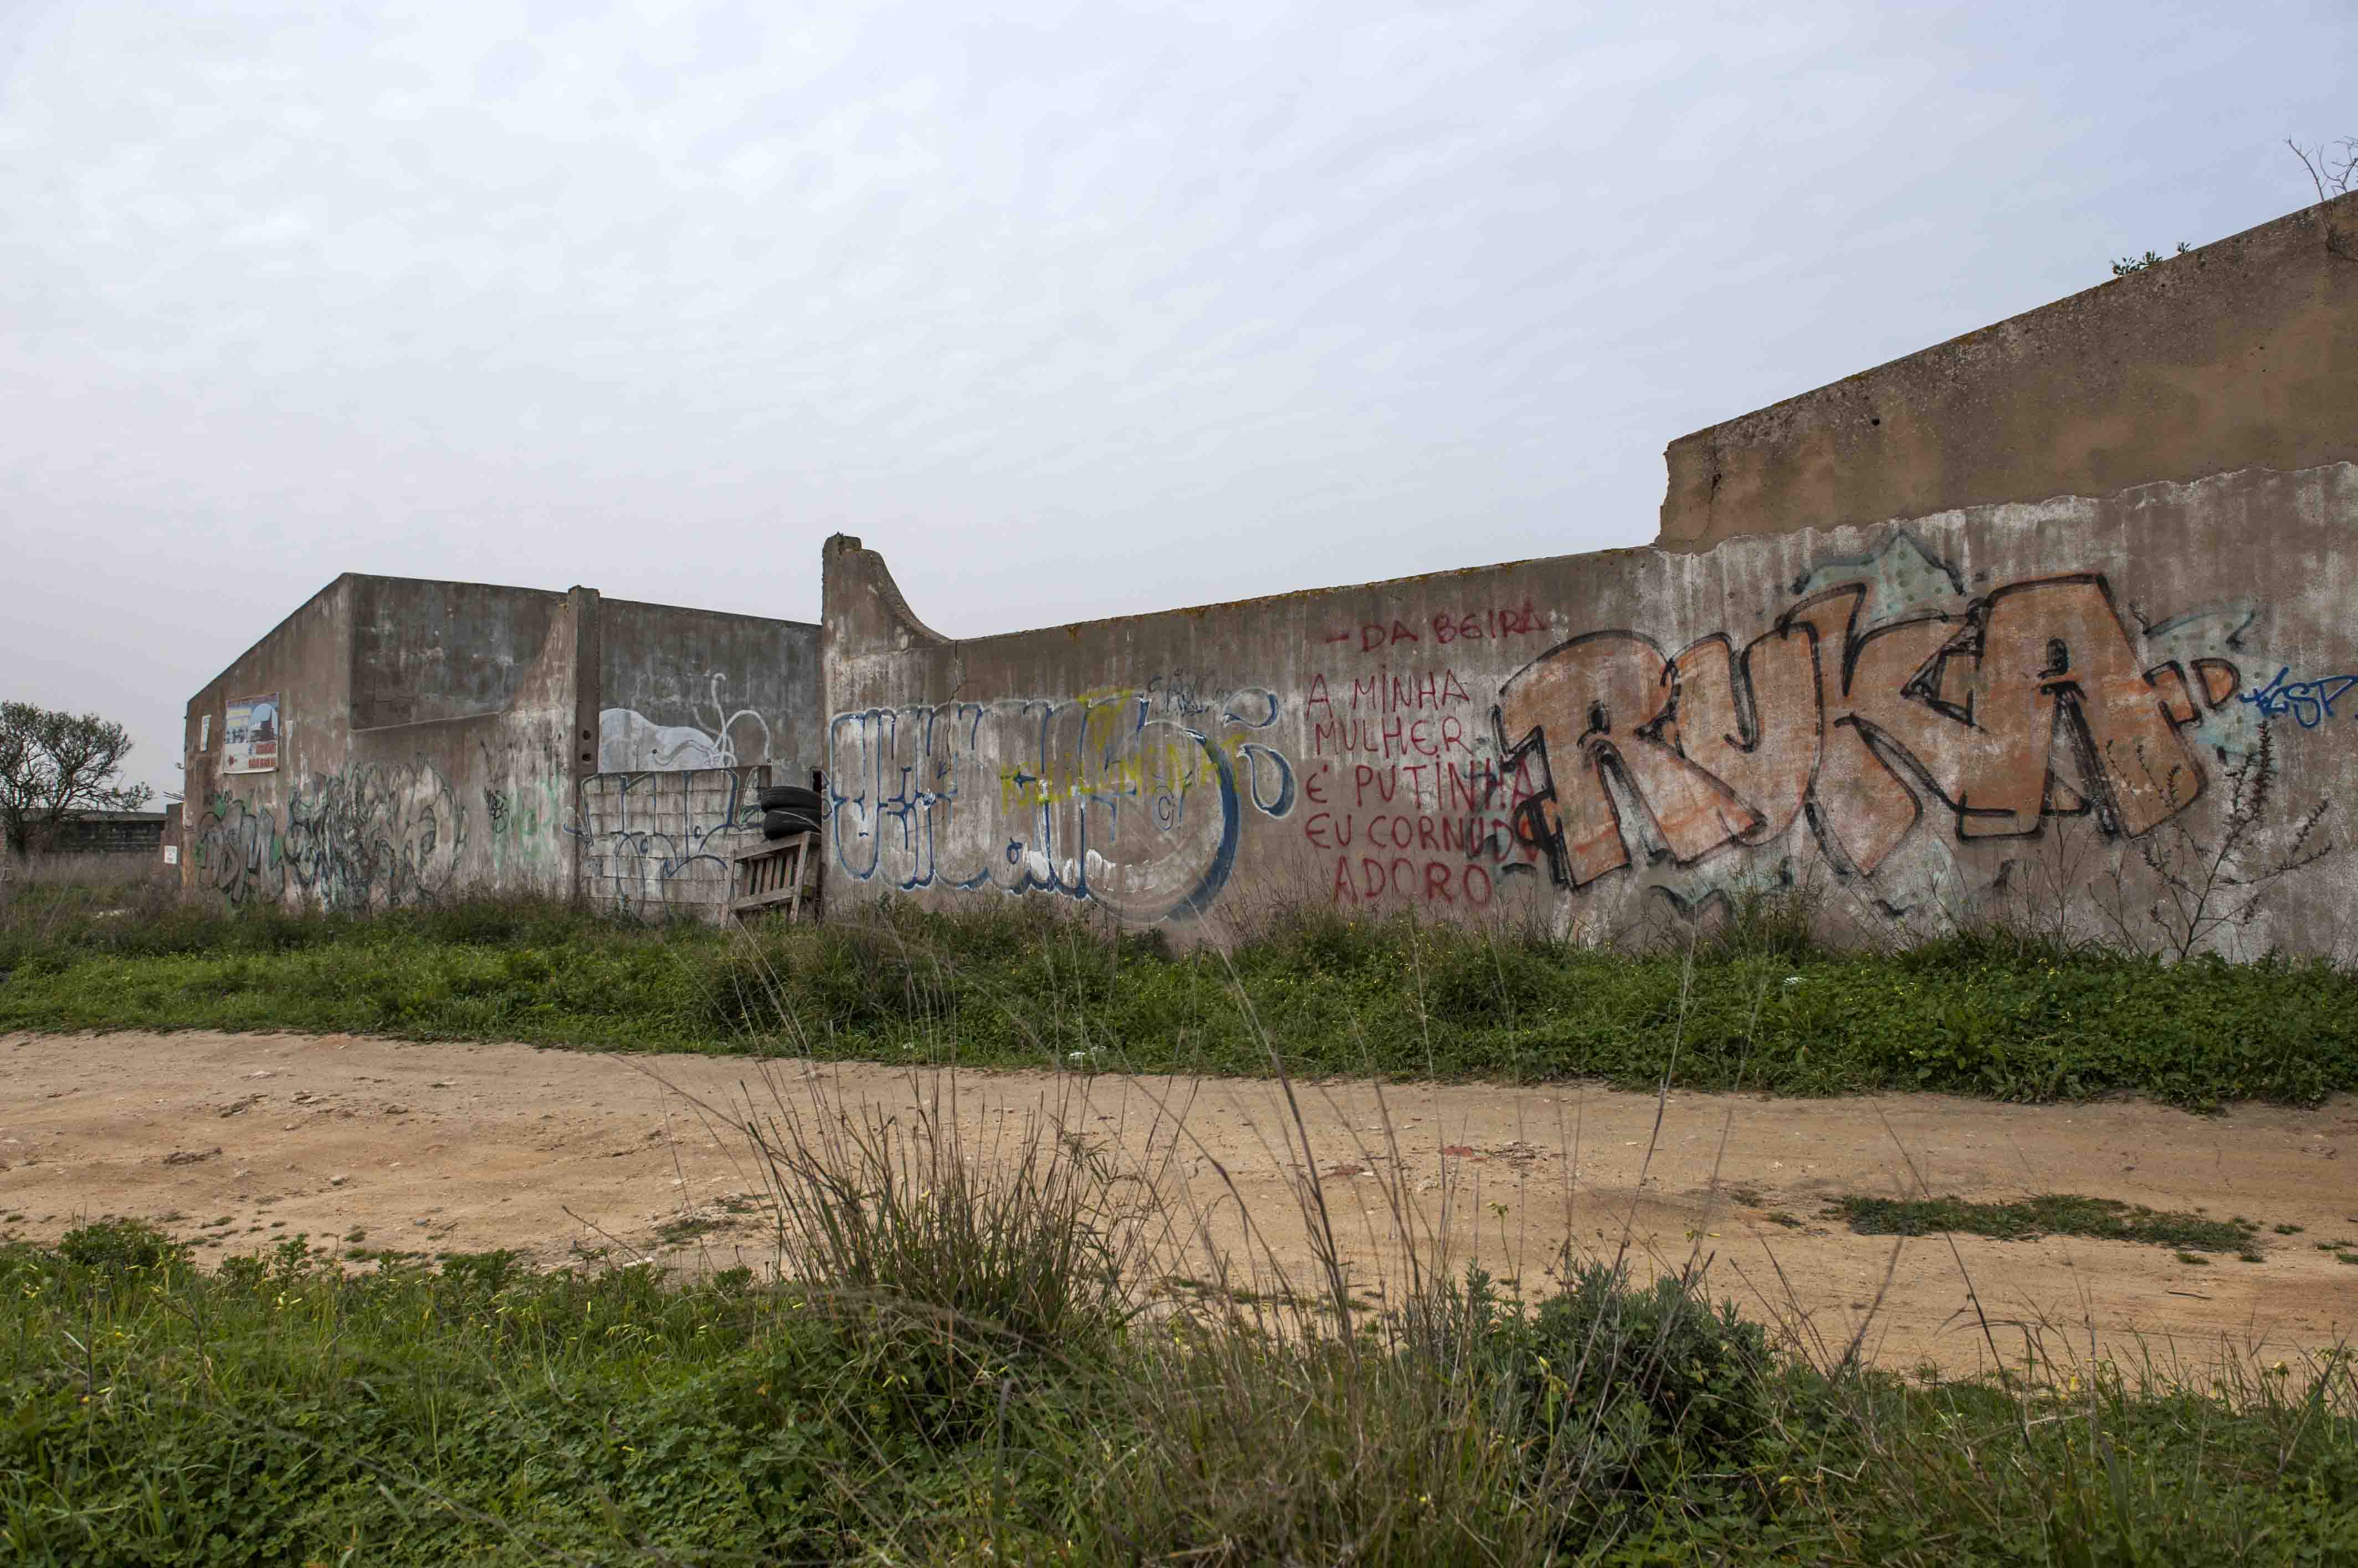
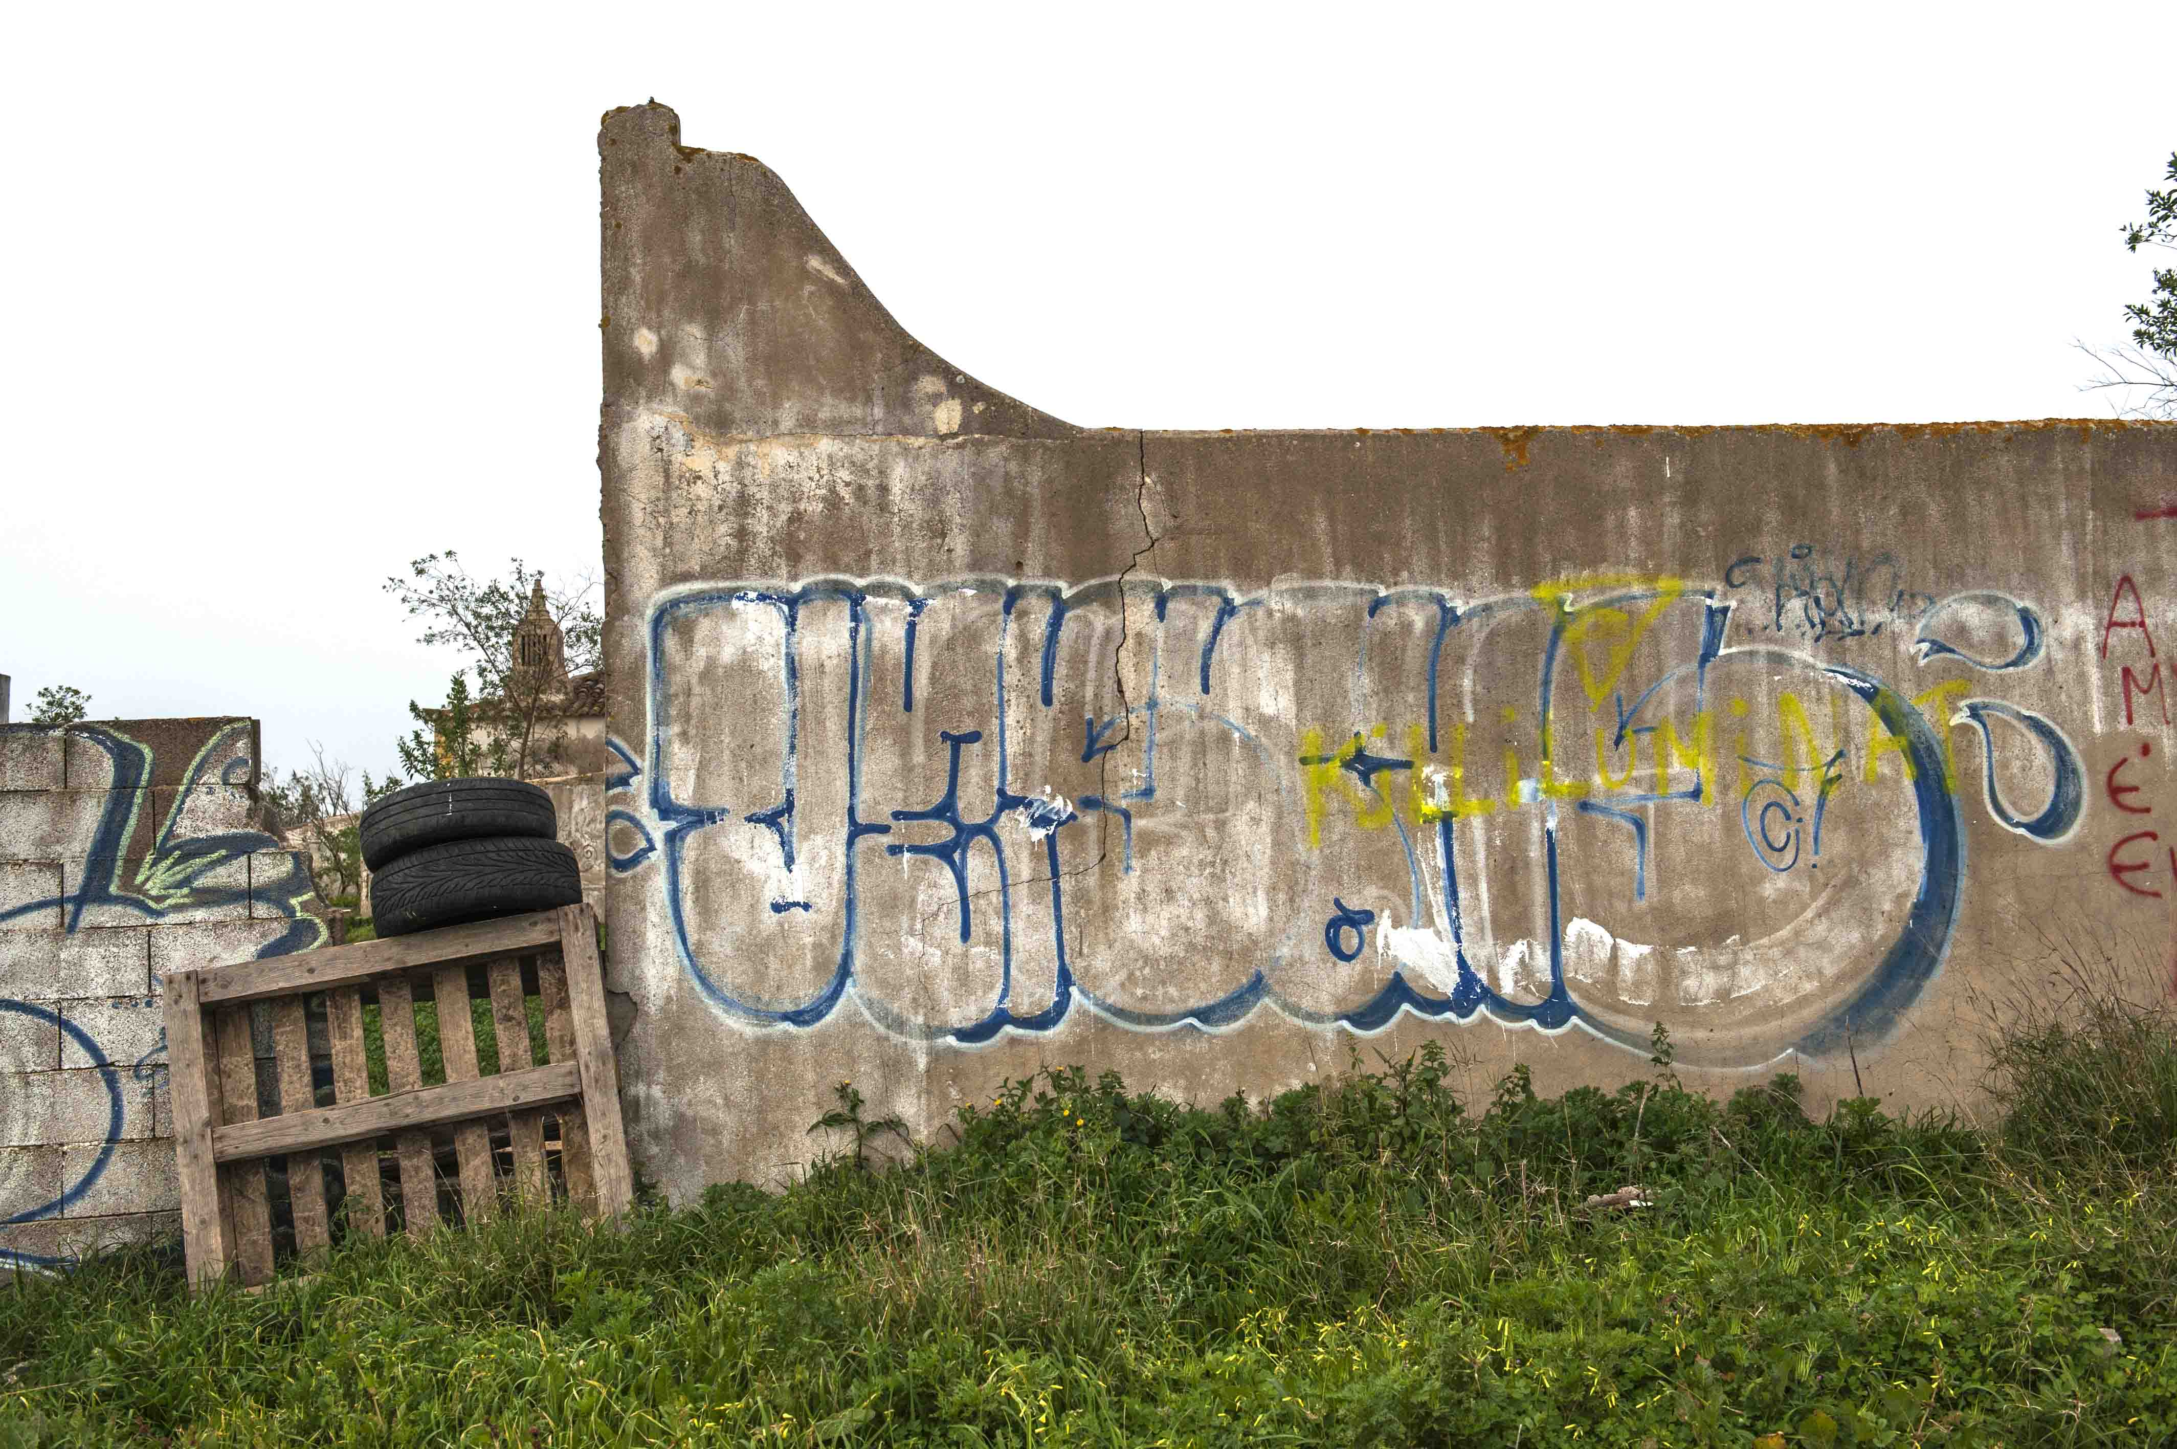
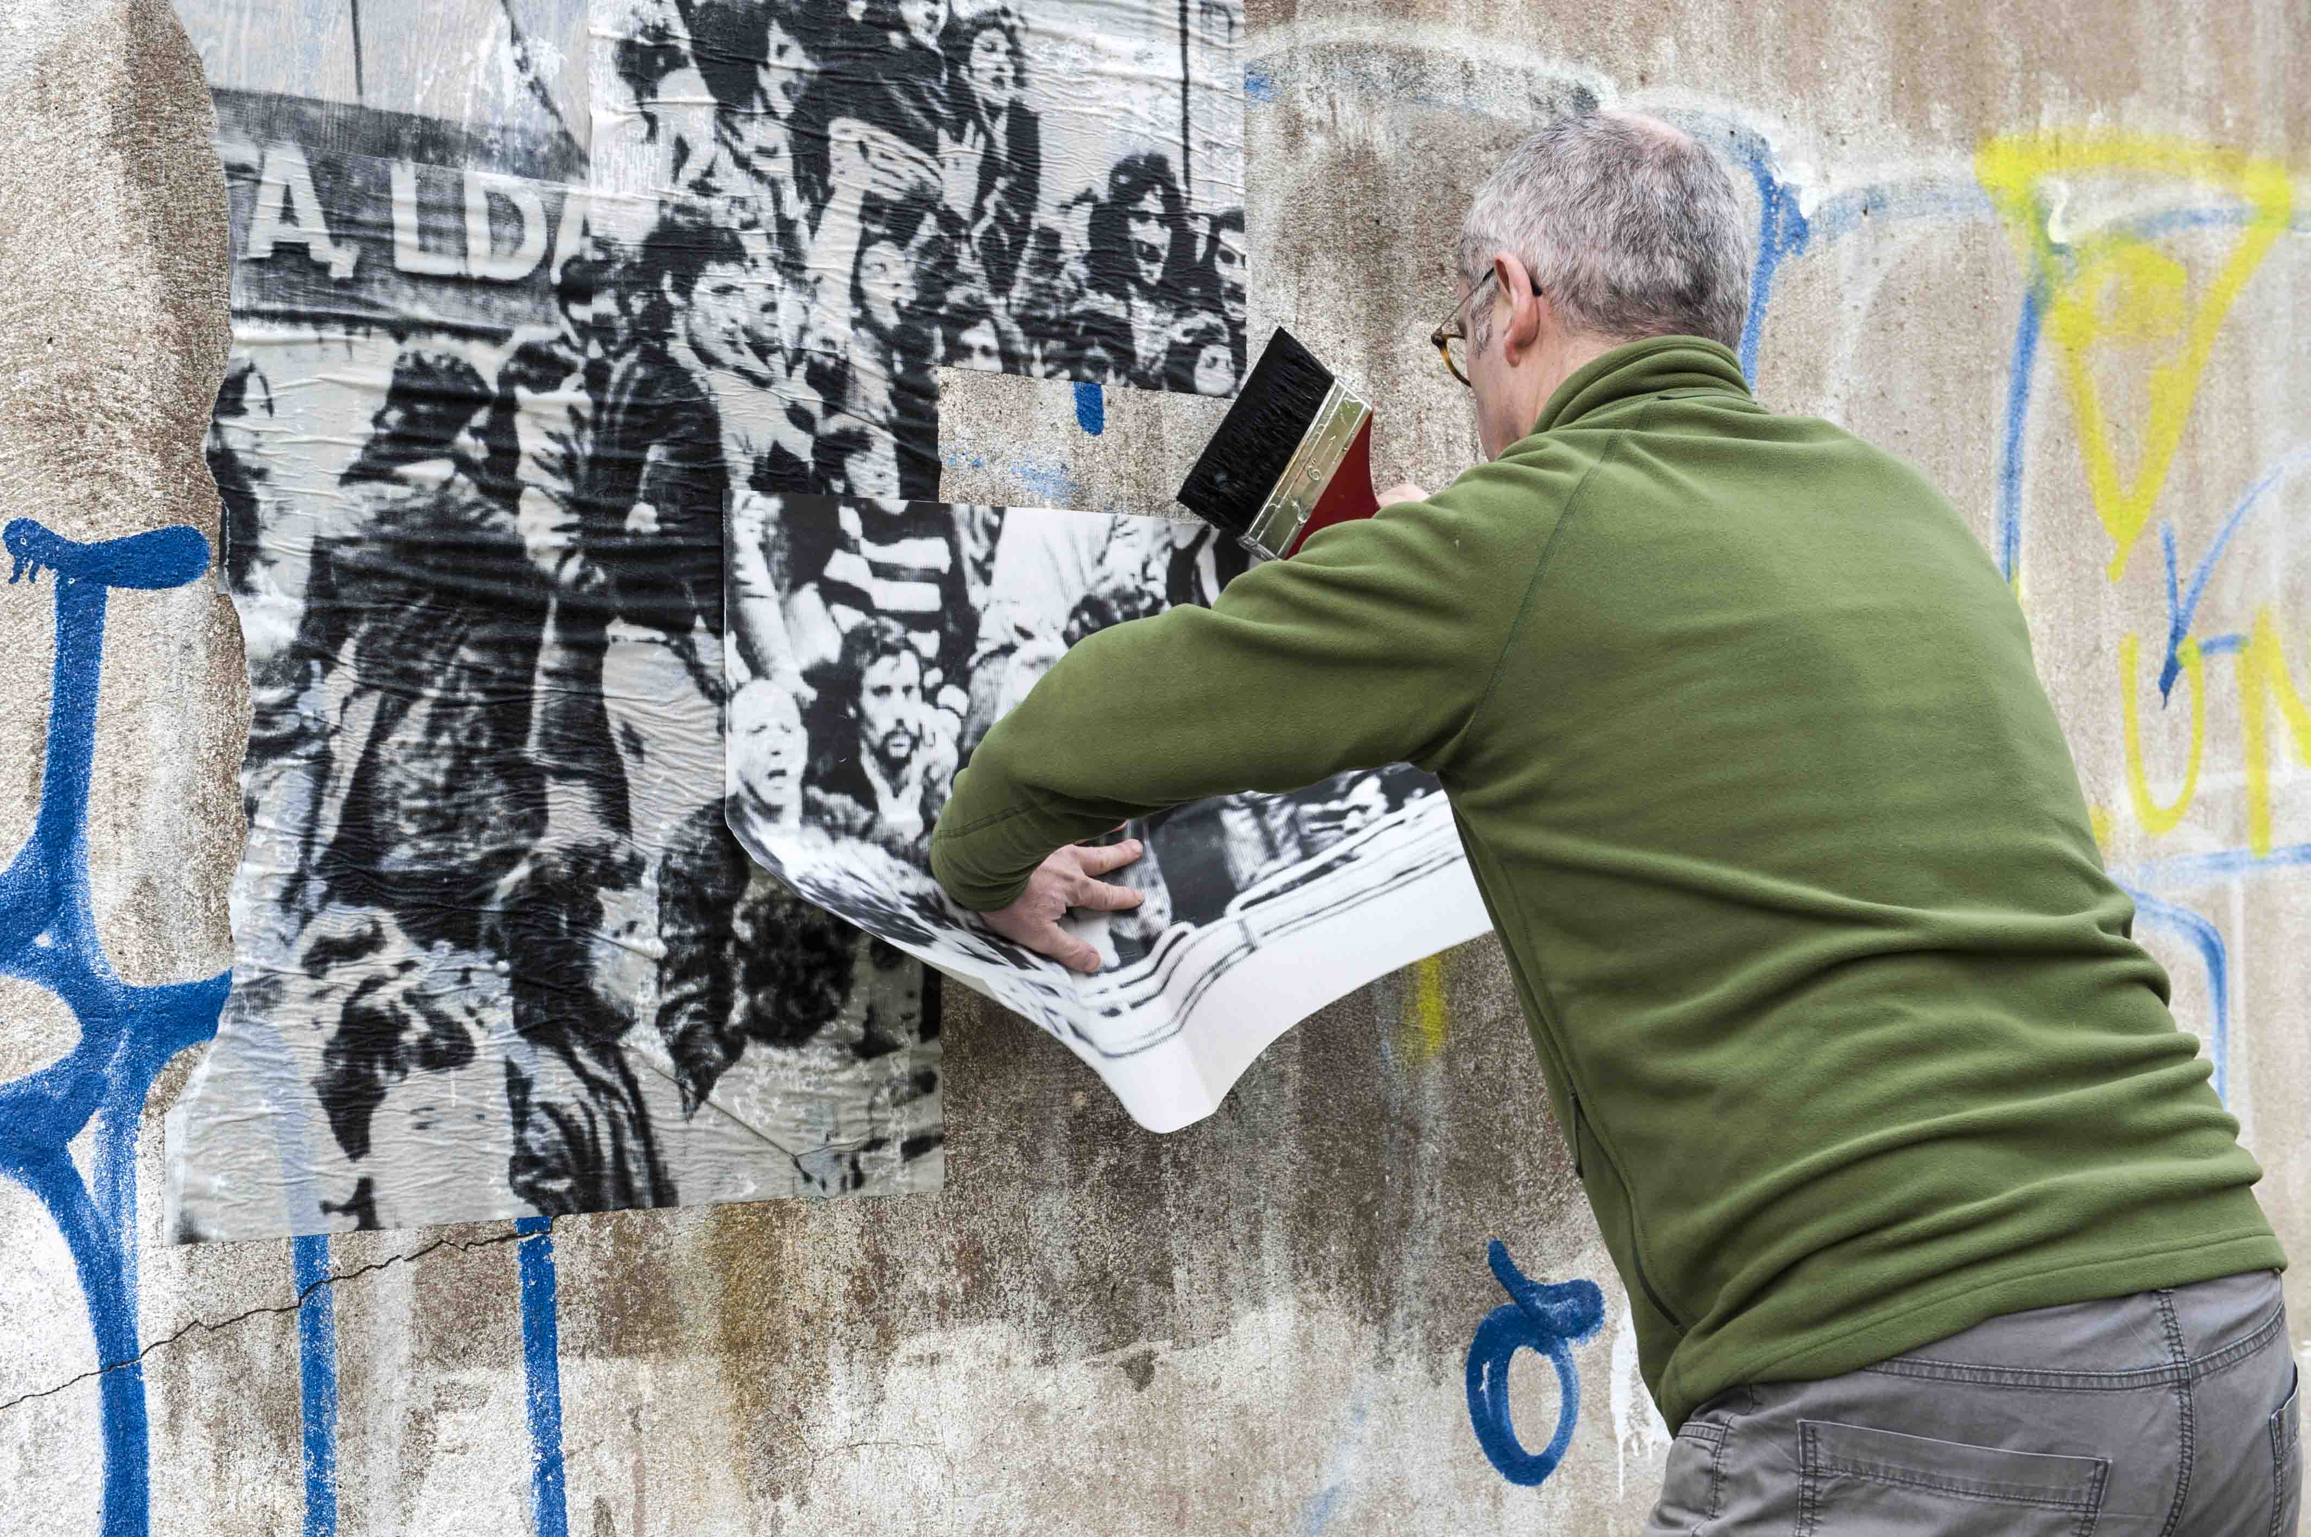
Site Work
Notes:
It was important for the project to re-enact the pasting of a revolutionary image. Site specific work took place in Portugal.
The process of taking an historic image and pasting back in the country after 40 years was intriguing and played around with notions of authenticity and cultural identity. Particularly as some of this imagery had been used since for advertising purposes in Portugal itself.

Slide 18
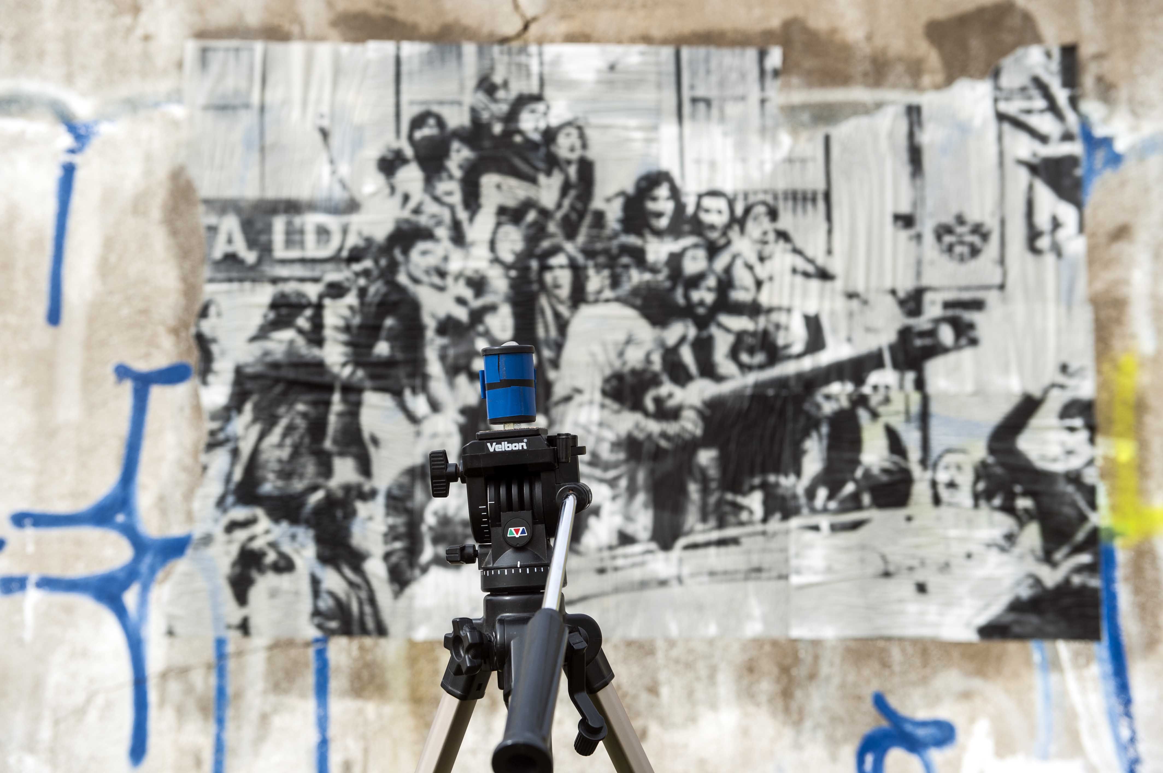
Pinhole Camera Photography
Notes:
In addition to documenting using a normal digital camera, I chose also to document the image and site using two other methods.
Pinhole camera – made from old 35mm film canisters and loaded with sheet film ‘Ilford Ortho Plus’ (this can be handled under red safety light)
Correct exposure was determined using an app on my phone called ‘Light Meter’
To calculate the f-stop of your pinhole camera visit this site
http://www.diyphotography.net/the-comprehensive-tech-guide-to-pinhole-photography/
A great book on how to build your own is:
Pin Hole Cameras – A Do It Yourself Guide by Chris Keeney

Slide 19
Notes:
Film developed then scanned digitally in order to be able to enhance contrast.

Slide 20
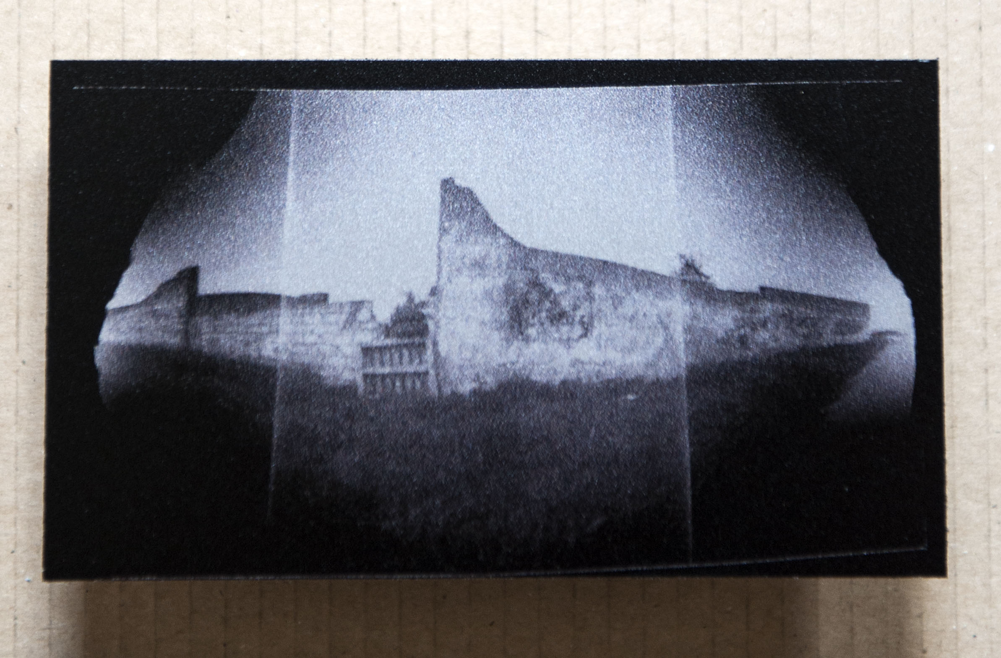
Aluminium Print
Notes:
Printed on to Aluminium Dibond (at Genesis Imaging ) www. Genesisimaging.co.uk
The effect was slightly grainy. This reinforced the notion of historical documentation being distorted/degraded over time.

Slide 21
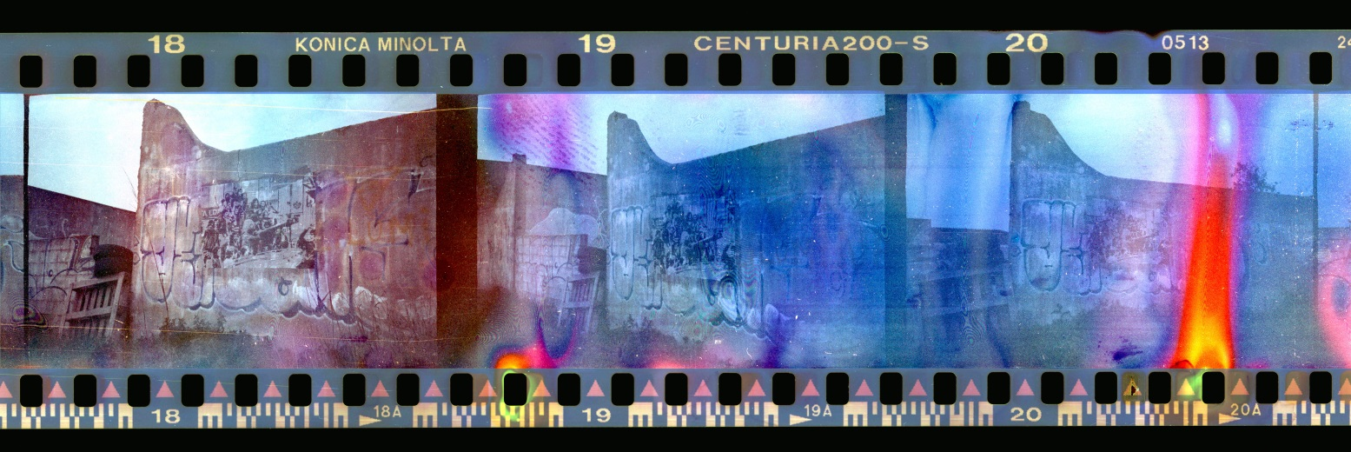
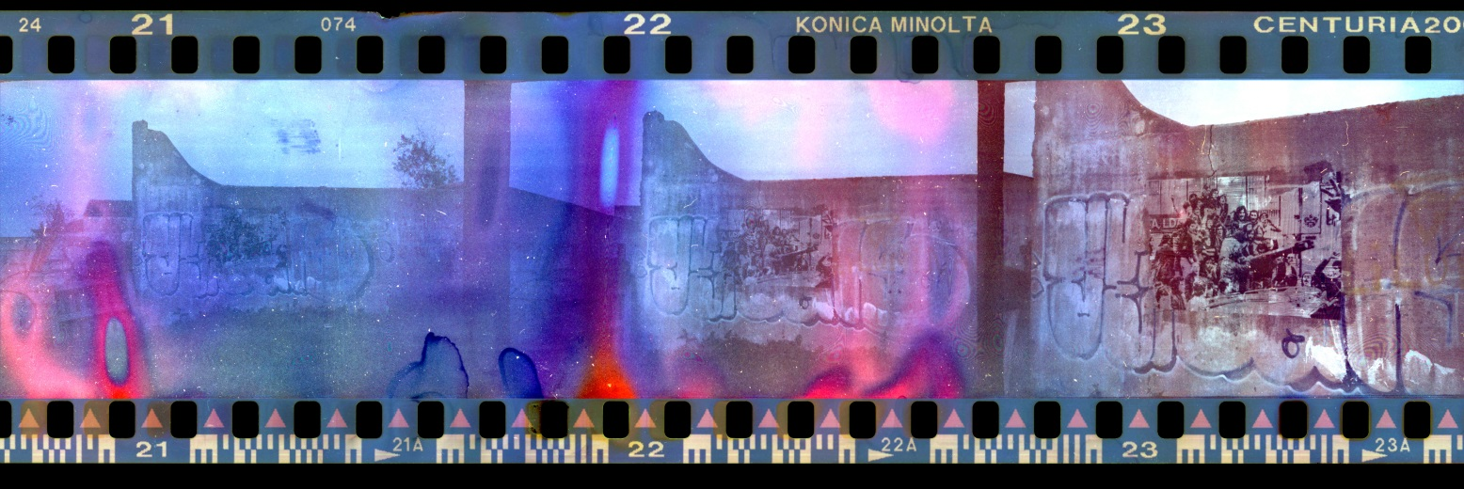
Distressed 35mm Film
Notes:
Distressed film – this method works for me, but I’m sure there are other techniques.
Get some out of date film stock (ebay is a good source for this)
Put the film rolls in a dishwasher on a hot wash – some water will get in to the film roll and the heat will also affect the photographic emulsion
Take out of dishwasher, place the film roll on it’s side and leave for 48 hours. By putting it on its side, means any water inside won’t drain away + will continue to act on the emulsion + the layers of film may stick to each other a bit.
You can’t (shouldn’t) load the film in this state into your camera as it will probably ruin the winding mechanism. So…
In a completely dark room (i.e pitch black no red safe light), pull the film from the roll casing and dry it thoroughly with a hair dryer. Then wind it back into the film roll casing.
Load it into the camera and fire away!
To develop it I take it to Boots the chemist. They are fine about developing distressed film as long as it’s only been in water and then dried thoroughly. I prefer to get them to only develop the film and not print it out. If asked to print they will cut the film.
Scan the film with a high resolution scanner and then tweak the images in Photoshop.
The images are completely unpredictable – most will be rubbish, but then occasionally there will be a gem ☺

Slide 22
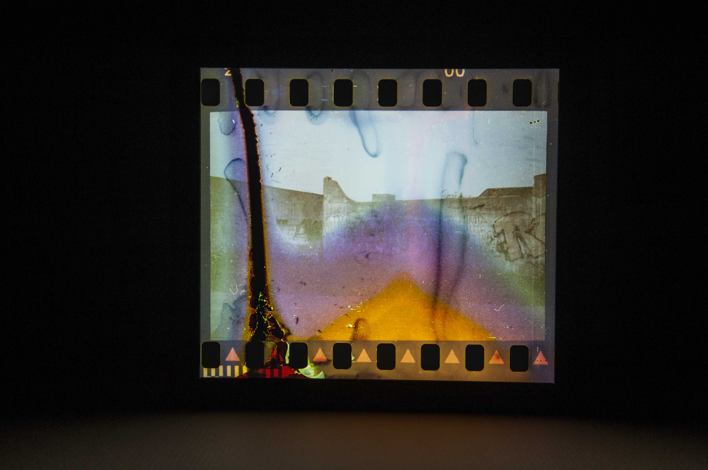
The Lightbox
Notes:
Images made into lightboxes. Although I had mine made at Genesis Imaging, lightboxes can be made fairly easily if you’ve got reasonable carpentry skills.
Print image on to transparency
You will need a layer of film (like tracing paper) that helps diffuse the light placed between the image and the lights
You can buy LED strip lights from B&Q

Slide 23
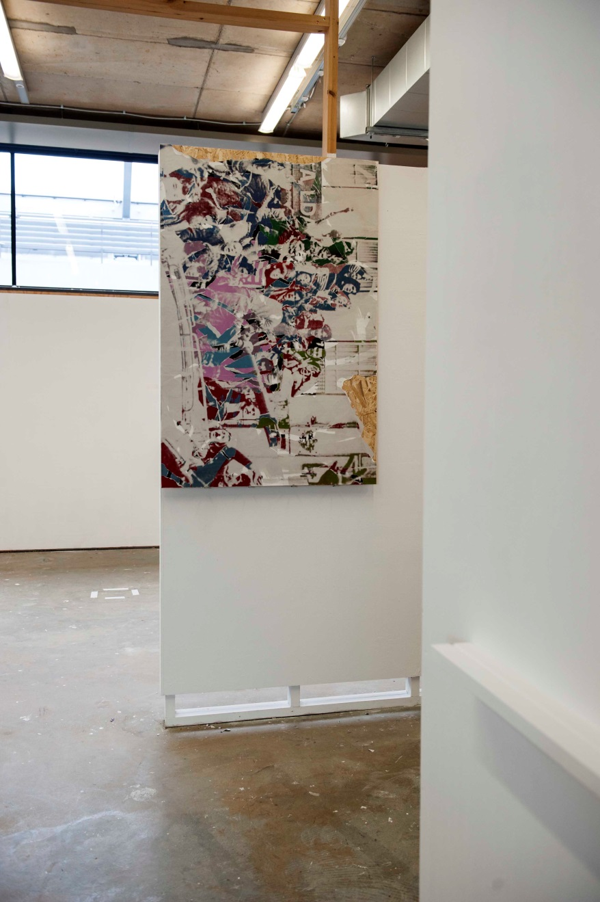
Degree Show Installation
Notes:
I was allocated a small cubicle space for my degree show (turn right before the image)
The first work seen by viewers is the décollage work 2U5IT4NIA. Its inversion is a commentary on how the commercial considerations of the art world often alter the original intention of the artist by taking the work out of context and placing it in an art gallery. Well known cases of this include Banksy’s work in which whole walls are removed and re-sited.

Slide 24
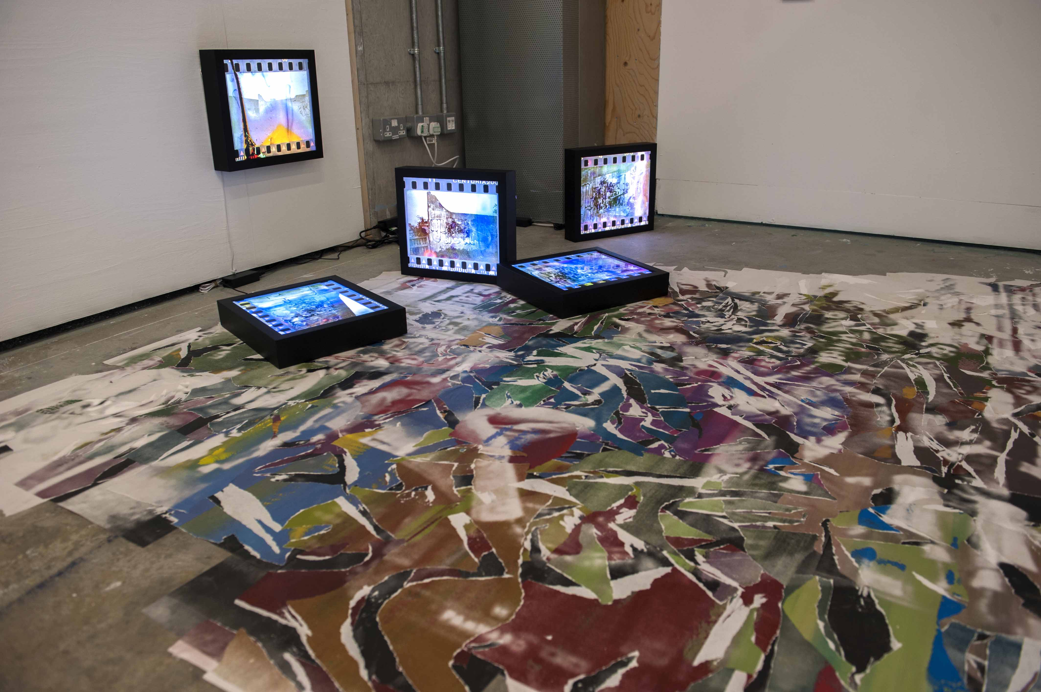
Notes:
Part of the Installation – view of the floor.
Another image from the revolution was appropriated and multiple screen prints made. The work was then created on site, being stuck to the floor and then ripped/torn using décollage method as before.
5 lightboxes placed on/near the floor (i.e deliberately not on the wall at eye level as in a gallery). By placing them on the floor, I was aiming to reduce their objectification as art objects

Slide 25
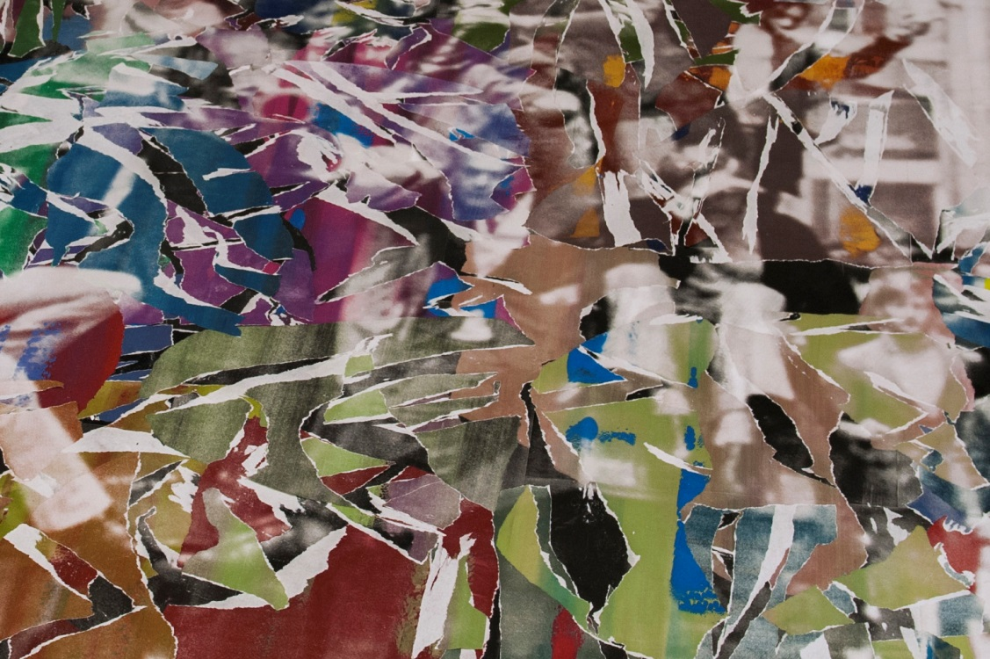
Notes:
Close-up

Slide 26
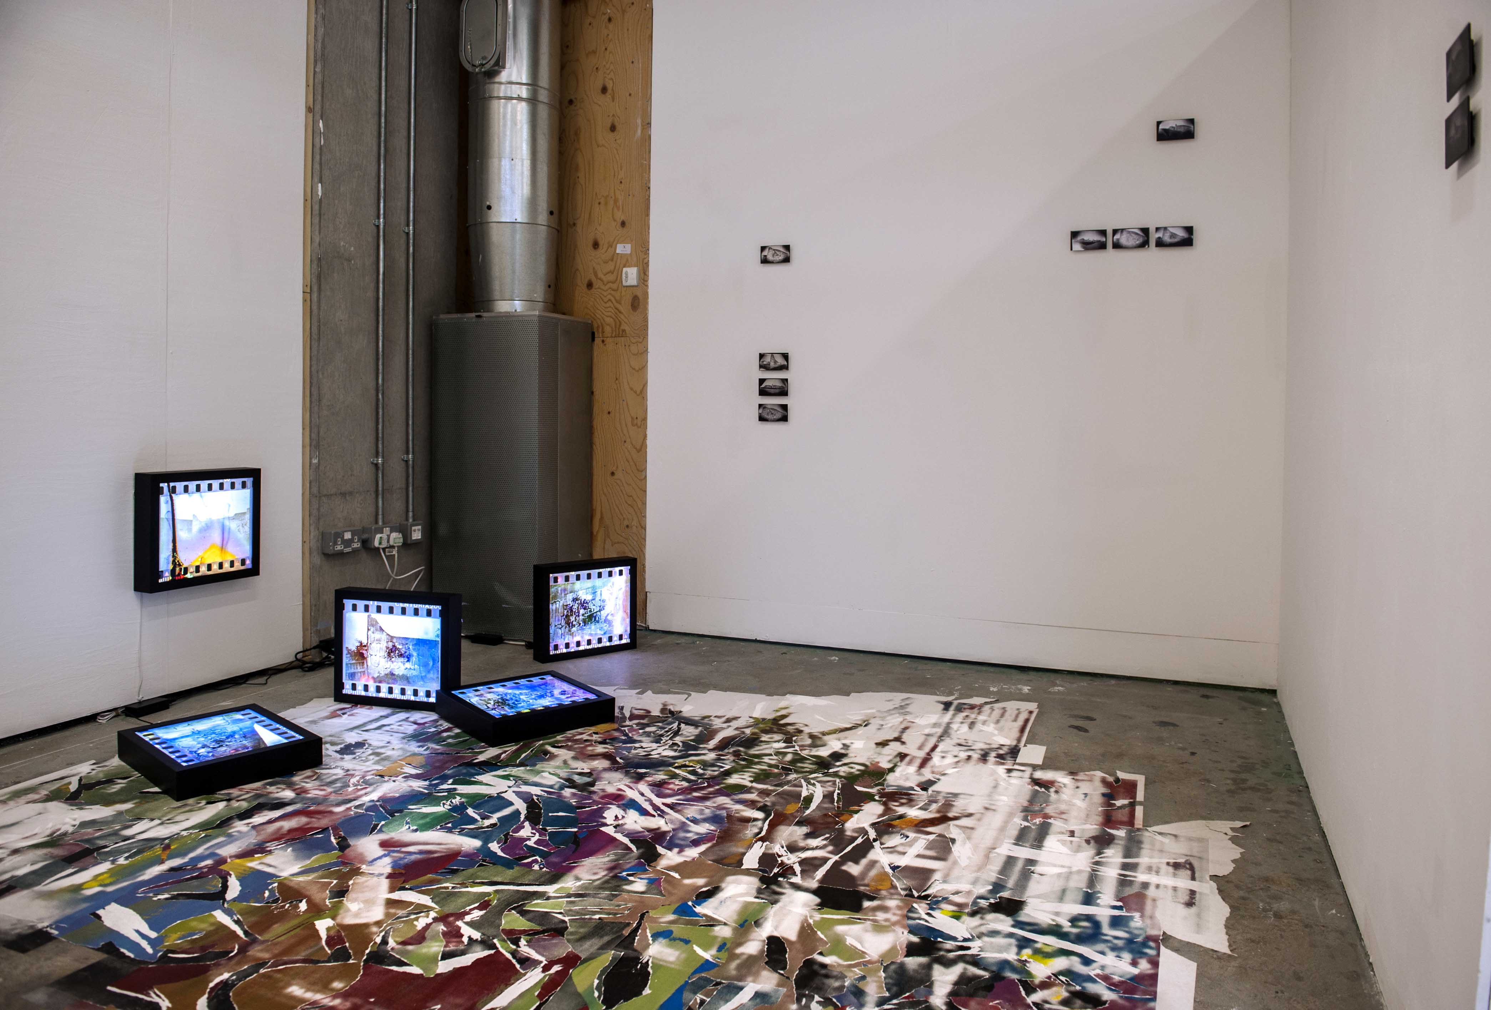
Notes:
The small Aluminium Dibond pieces were positioned on the opposite wall to the entrance. The intention being to force the viewer to walk over the floor piece in order to see them.
The action of people walking on the floor piece degraded the image further. By walking on it, we too are complicit in the erasure of history.
‘Unfortunately’ such is the conditioning ‘not to touch artwork’ that most people did not walk on the floor work, they either squeezed down the side or simply viewed it from the entrance to the cubicle. This in itself though was an interesting study on social conditioning.

Slide 27
Artists that moved me from A to B

Slide 28
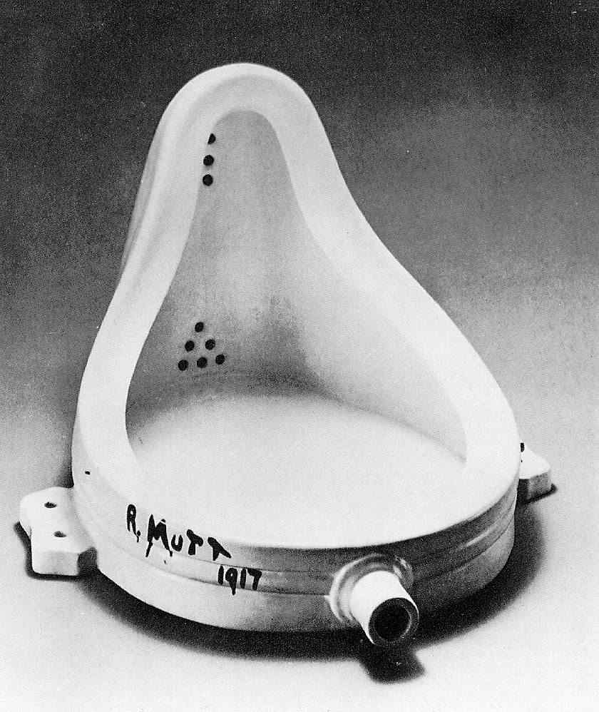
DADA – The Art Movement
Key Artists
Raoul Hausmann
Hannah Höch
Marcel Duchamp
Man Ray
Hans Arp
Marcel Duchamp
‘Fountain’ (1917)
Notes:
Turned the art world completely on its head and has affected the way people view/make art to this day. No other movement has had such a profound influence.
Dadaism was not exclusively an artistic, literary, musical, political or philosophical movement, it was all of these and yet none of these.
Emerged at the time that Europe was embroiled in WW1. It was anti-establishment with a capital A!

Slide 29
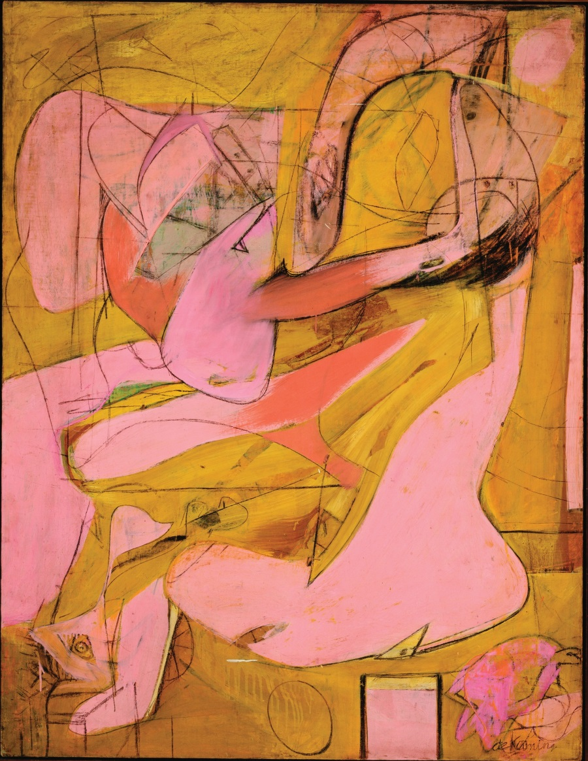
Abstract Expressionism – Art Movement
Key Artists
Jackson Pollock
Willem de Kooning
Mark Rothko
Clyfford Still
Robert Motherwell
Franz Kline
Willem de Kooning
‘Pink Angels’ (1945)
Notes:
Used paint in a completely new way focussing on spontaneity and the sub-conscious action (although there are exceptions).
An anti-figurative aesthetic originating in New York
Currently a major exhibition at The Royal Academy, London until 2 January 2017

Slide 30
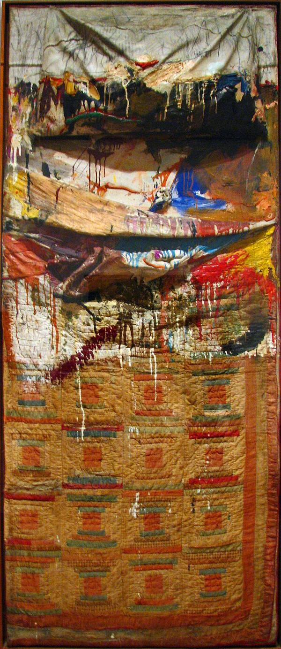
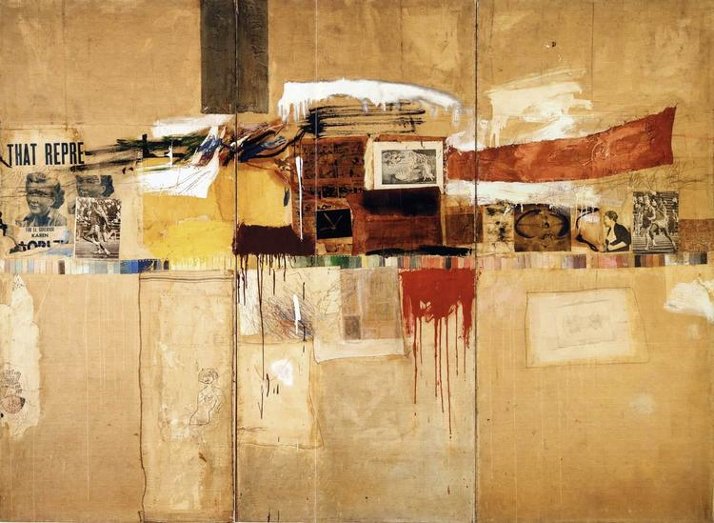
Robert Rauschenberg
‘Rebus’ (1955)
‘Bed’ (1955)
Notes:
Rauschenberg’s ‘Bed’ is an example of a ‘Combine’ in which he attached found objects to a canvas. Here his bed was the canvas. ‘Painting relates to both art and life’ – an intimate self-portrait.
Similar theme tackled by Tracey Emin in ‘My Bed’ (1998)
Exhibition at Tate Modern 1 December 2016 – 2 April 2017

Slide 31
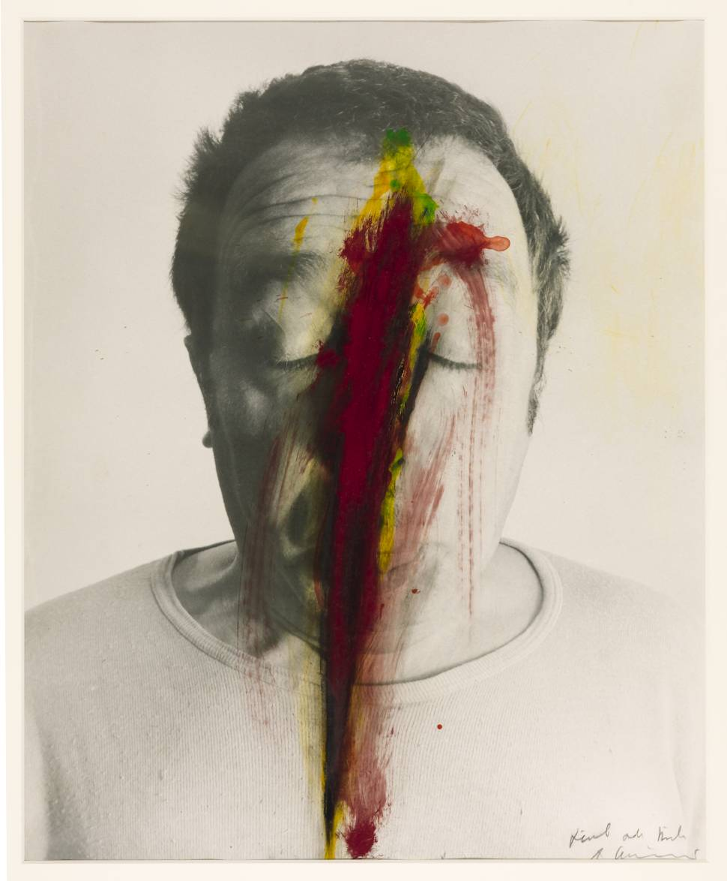
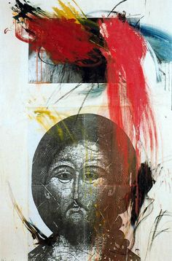
Arnulf Rainer
‘Untitled (Face Farce)’ (1971)
From the series ‘Bible Overpaintings’
Notes:
Rainer’s work deals with the destruction of forms, including blackening and overpainting of existing images
Associated with the Viennese Actionists – this involved a lot of work with bodies and blood and carried out under the influence of drugs.

Slide 32
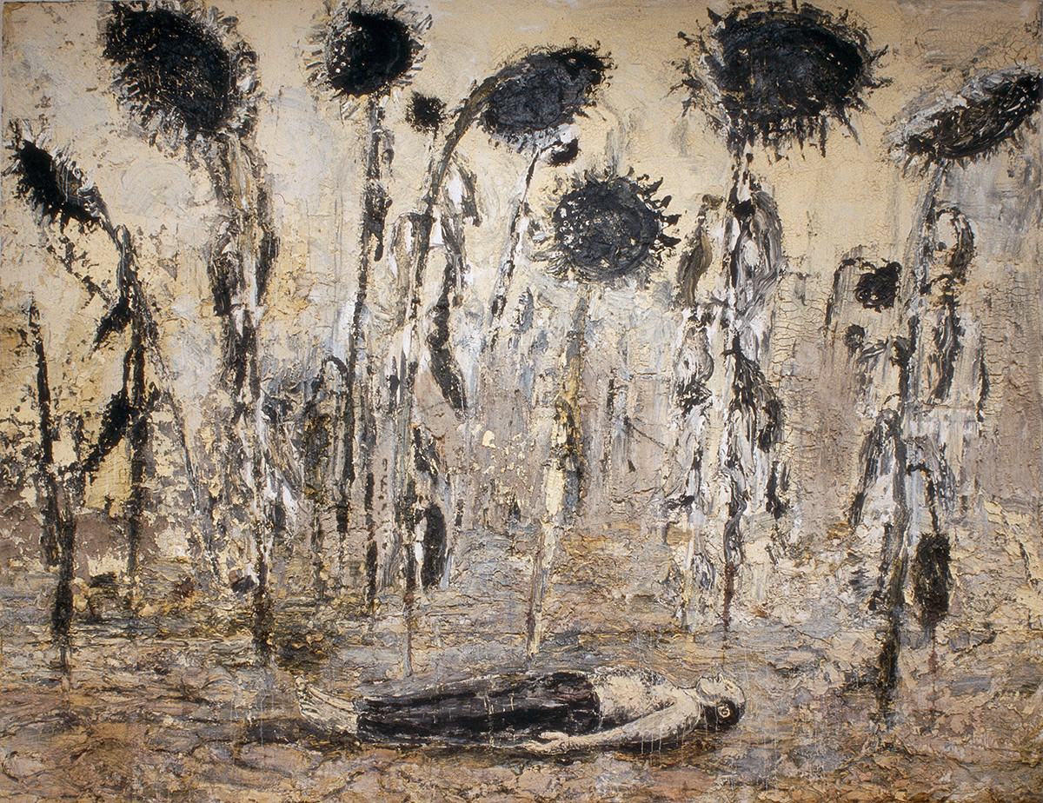
Anselm Kiefer
‘The Orders of the Night’ (1996)
Notes:
Kieffer’s work was groundbreaking at a time when painting was considered dead. Huge installations and canvasses incorporating very heavy Impasto + materials such as lead, glass, dried flowers and hay.
Subject matter is largely confronting Germany’s recent past regarding the Holocaust, in itself daring as it was largely a taboo subject when he started.
BBC Documentary to coincide with Exhibition at The RA in 2014 available online https://vimeo.com/112053965

Slide 33
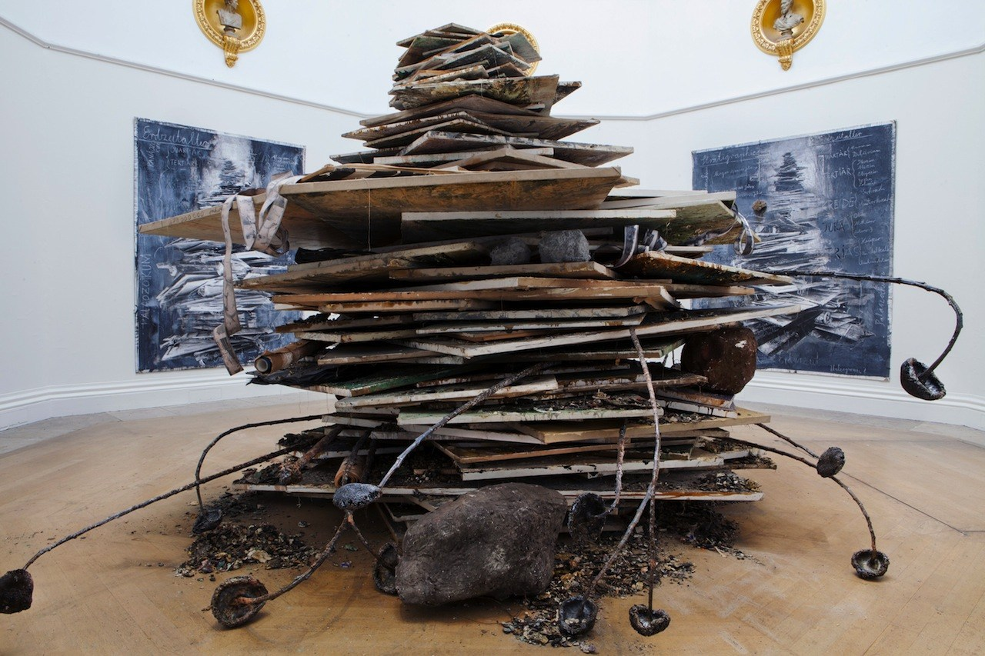
‘Ages of the World’ (2014)

Slide 34
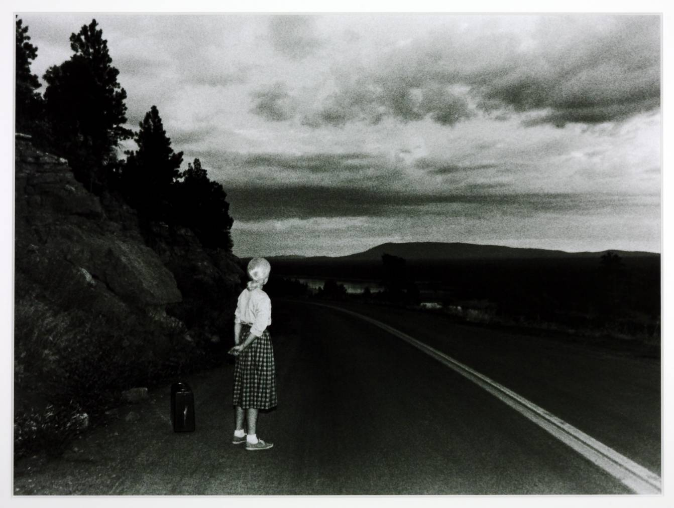
Cindy Sherman
‘Untitled Film Still #48’ (1979)
‘Untitled #354’ (2000)
Notes:
Considered a ‘Feminist’ artist, Cindy Sherman uses herself as the subject by placing herself in front of the camera in order to comment on the stereotypes within film, media and society regarding the portrayal of women.
Two major exhibitions currently in London explore Feminism in art:
The Guerrilla Girls at the Whitechapel Gallery until 5 March 2017
Feminist Avant-Garde of the 1970s at The Photographer’s Gallery until 15 Jan 2017

Slide 35
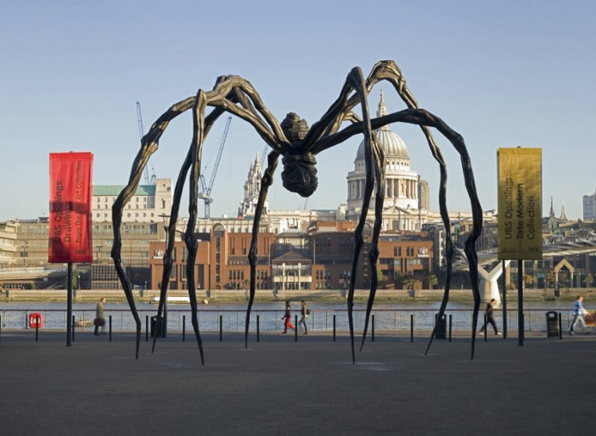
Louise Bourgeois
‘Maman’ (1999)
Notes:
Louise Bourgeois’ work deals largely with the family, sexuality, the body and the subconscious.
Maman is a representation of her mother, strong, intelligent and protective (also happened to be a weaver)

Slide 36
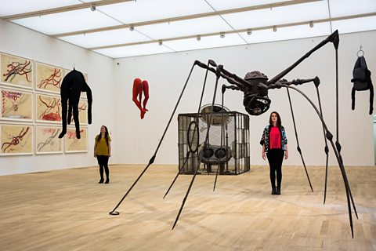
Louise Bourgeois - Artist Rooms Tate Modern
Notes:
This is the room dedicated to Louise Bourgeois at the new Tate Modern extension.

Slide 37
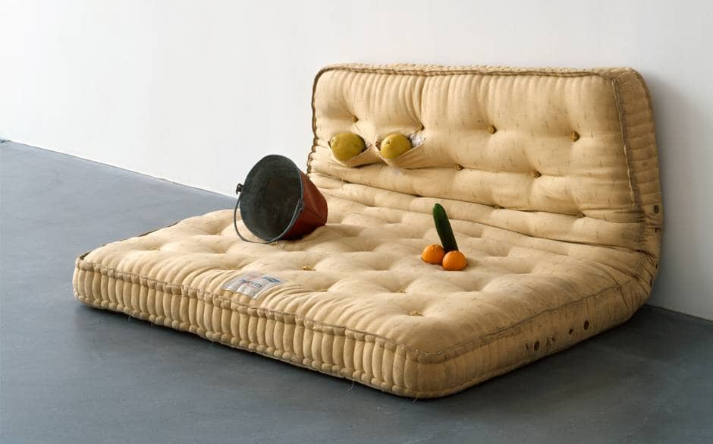
Sarah Lucas
‘Au Naturel’ (1994)
Notes:
Explores society’s depiction of the female body. She challenges stereotype and the misogynistic culture prevalent in society today. Often crude but sharp!

Slide 38
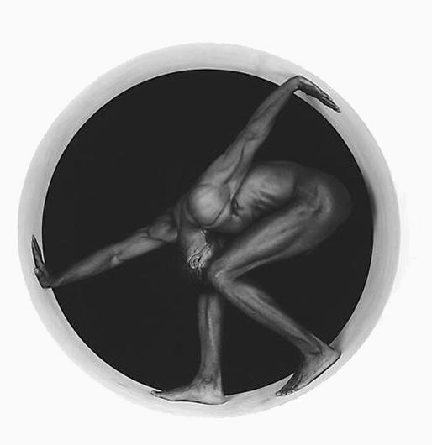
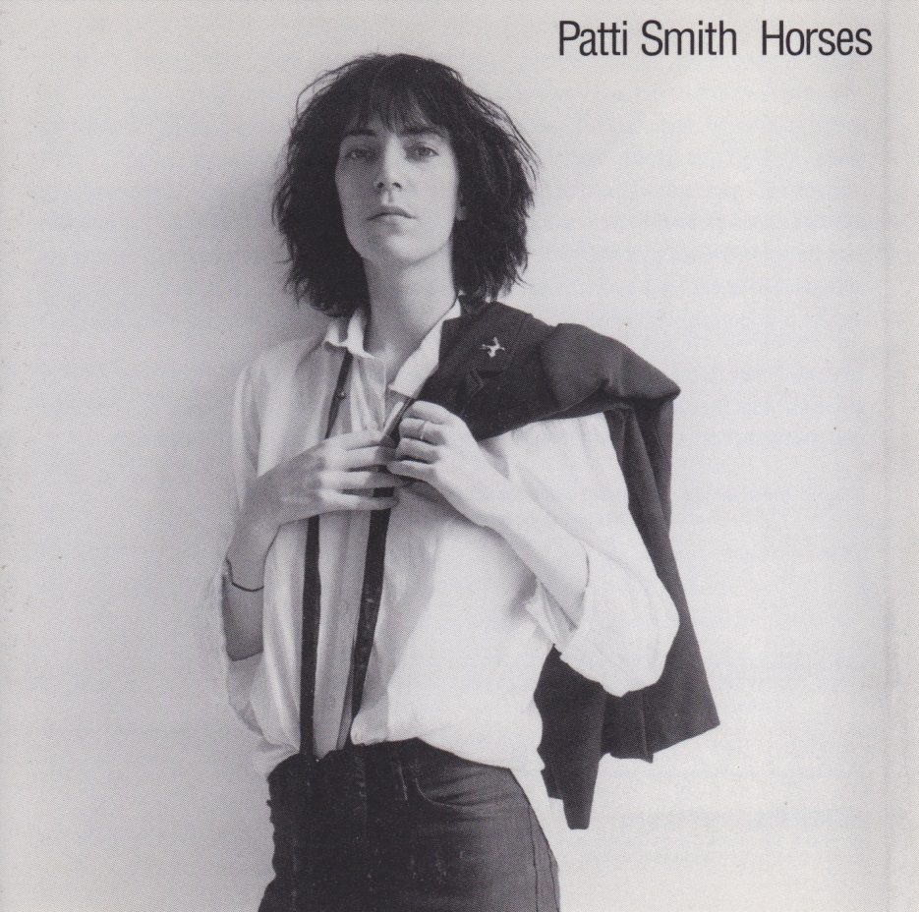
Robert Mapplethorpe
Horses Album Cover (1975)
‘Thomas’ (1987)
Notes:
Hit right-wing America in the 1980s head on, with his explicit depictions of gay lifestyles and sexual practices. At the height of the AIDS epidemic in America. Took very difficult photographs and presented them in a classical form.
Soul mate of Patti Smith famously photographing the cover for her debut album ‘Horses’ (and also ‘Wave’). ‘Horses’ has the best opening line of any album – a real statement of intent.
Recent film release ‘Mapplethorpe – Look at the Pictures’ available now on DVD.

Slide 39
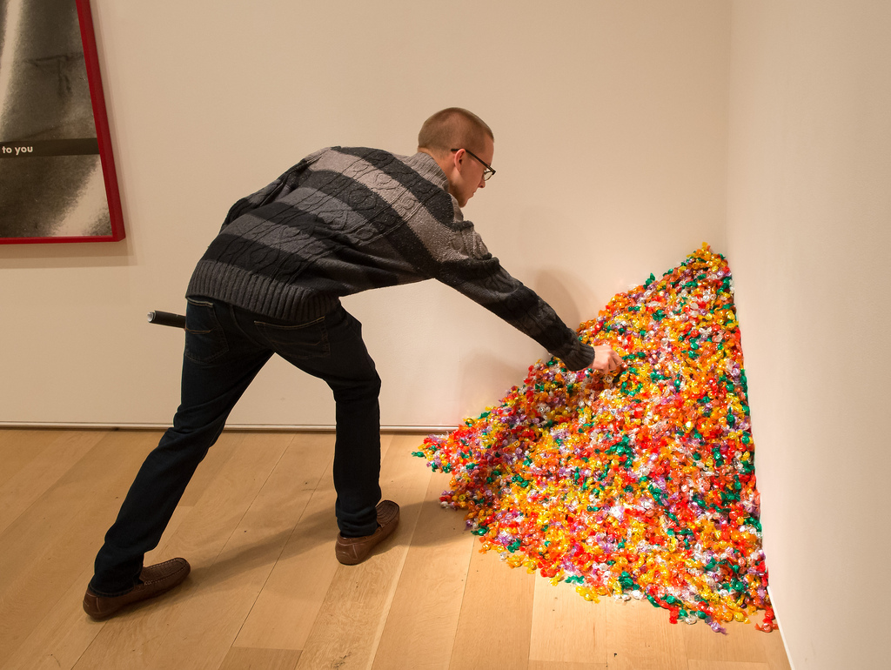
Felix Gonzalez-Torres
‘”Untitled” (Portrait of Ross in L.A)’ (1991)
Notes:
A great example of the relational aesthetic. The ‘Ross’ referred to in the title is Gonzalez-Torres’ lover who had contracted AIDS. The pile of sweets starts off as the same weight as Ross before AIDS. People are encouraged to take sweets, the reduction in the pile of sweets represents the weight loss experienced by Ross during the disease.
Creates a strong sense of empathy between artist/lover and audience.

Slide 40
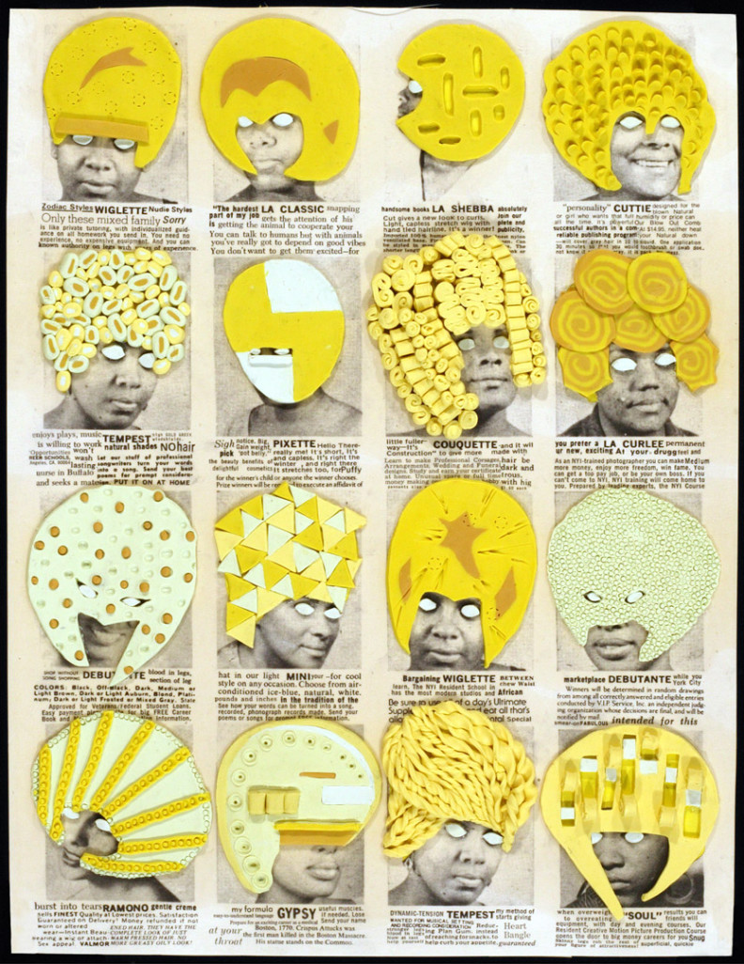
Ellen Gallagher
Part of ‘Delux’ (2004-2005)
Notes:
Dealing largely with Black cultural identity. This work looks at the bombardment through advertising, of hair products aimed at black women in order to achieve ‘perfect’ hair (i.e straight)

Slide 41
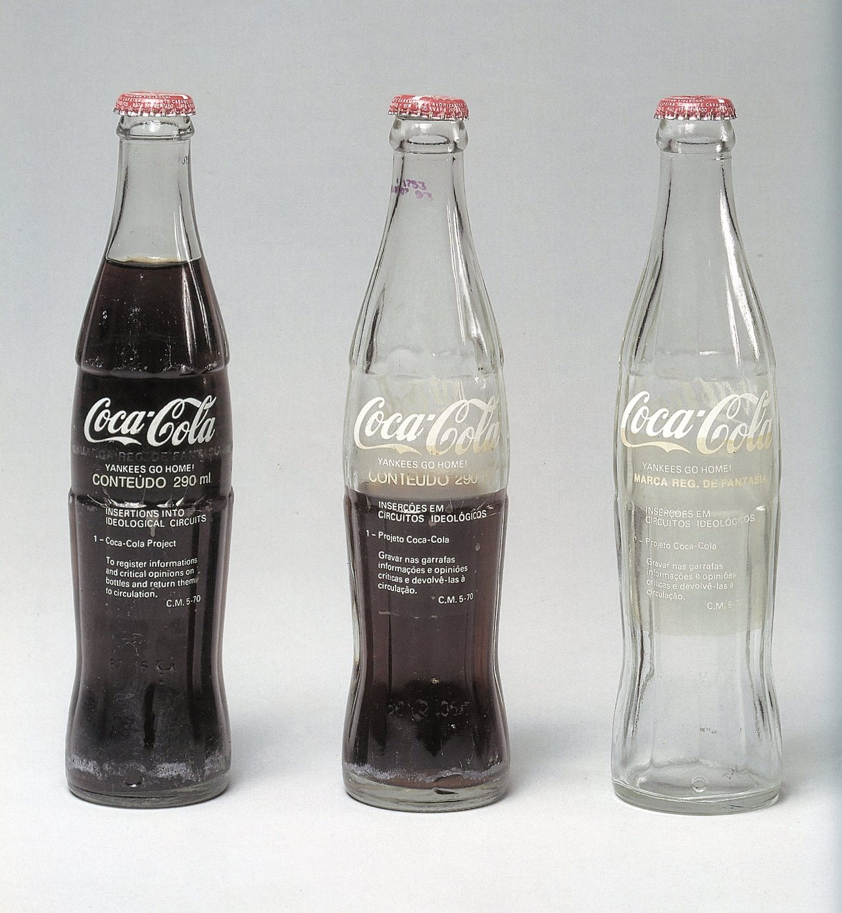
Cildo Meireles
‘Insertions into Ideological Circuits’ (1970)
Notes:
Superb example of political activist art. Ubiquitous glass coke bottles were ‘altered’ by writing political messages on them in white and then reintroducing them back into the recycling process. When the bottles were refilled with coke, the message became visible.
This was at a time when Brazil was under a military dictatorship supported by the USA. The message read ‘Yankees go home’

Slide 42
Santiago Sierra
‘160cm Line Tattooed on 4 People’ (2000)
‘7 forms measuring 600 x 60 x 60cm
constructed to be held horizontal to a wall’ (2010)
Notes:
Very ‘of this moment topic’ although he has been dealing with this topic for a long time. Essentially, Santiago Sierra looks at the exploitation of migrant labour and how we are all complicit in it.
Those who have ‘nothing’ and form the underbelly of our Western society are used in his works to highlight the exploitation.
Controversial in that he is criticised for exploiting the workers himself in order to highlight their plight.

Slide 43
Adam Broomberg & Oliver Chanarin
‘The Day Nobody Died III, June 10’ (2008)
Notes:
Broomberg and Chanarin deal with controversial subject matter in their photographic work. See their award winning work ‘War Primer 2’ which won numerous international prizes.
The piece shown here is a criticism of the censorship that happens in modern warfare. They were attached to a battalion in Afghanistan but were highly restricted regarding what they were allowed to photograph. i.e what we see is not what actually happens. As a criticism of this censorship, each day they exposed rolls of film. This one is the result of a roll of film being exposed on a day that no British soldier died.

Slide 44
Website: www.ricardopimentel.co.uk
Twitter: @ricpimentel65
Instagram: @ricardopimentelworks

